Slide 1
Guidance for Use of Dayton MMRS SALT Triage Materials
David N. Gerstner
MMRS Program Manager
Dayton Fire Department
www.DaytonMMRS.org
937-333-4551
david.gerstner@daytonohio.gov

Slide 2
Objective
Be able to quickly and effectively use Dayton MMRS SALT Triage Materials, including:
“Live” Triage Tags
Training Triage Tags
Exercise Triage Tags
Triage Ribbon Kits
Transport Log
Transport Worksheet

Slide 3
DAYTON MMRS TRIAGE MATERIALS
Presentation covers MATERIALS
For instructions on use of SALT, see GMVEMSC Standing Orders and separate video/PowerPoint at:
www.gmvemsc.org
www.DaytonMMRS.org

Slide 4
Inventory

Slide 5
DAYTON MMRS TRIAGE MATERIALS
GMVEMS Council adopted SALT Triage on recommendation of Dayton MMRS Triage Committee after approval by EMS Region 2 RPAB
Dayton MMRS agreed to provide Triage Materials
Materials have been distributed to County EMAs for further distribution to EMS agencies

Slide 6
DAYTON MMRS TRIAGE MATERIALS
Two types of triage material sets:
Triage Ribbon Kits
Transport Group Materials
Triage Tags (“Live”) included in clipboard

Slide 7
DAYTON MMRS TRIAGE RIBBON KIT

Slide 8
DAYTON MMRS TRIAGE MATERIALS
Triage Ribbon Kit:
Triage Ribbon Case (pre-assembled with six rolls of colored ribbons)
Scissors
Flashlight
Grease pencil
SALT Triage flowchart
Place where each agency can mark the agency and apparatus nomenclature

Slide 9
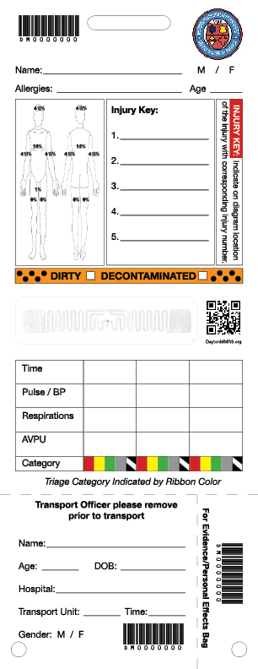
Transport Group Clipboard

Slide 10
DAYTON MMRS TRIAGE MATERIALS
Triage/Transport Tags and Materials:
Storing clipboard (with MMRS logo) pre-assembled with:
Shrink-wrapped pack of 25 Triage Tags
Shrink-wrapped pack of 10 Transport Officer WorkSheets
Shrink-wrapped pack of 10 Transport Officer Logs
Grease pencil, pen, and a carabiner for the Transport Officer to use to hold bottom section of Triage Tags
Instruction Sheet explaining Tags, Ribbons, and Transport Sheet and Log

Slide 11
DAYTON MMRS TRIAGE MATERIALS
Materials available electronically at DaytonMMRS.org
Transportation Officer WorkSheets
Transport Officer Logs
Instruction Sheet
Videos and Powerpoints
Images of Triage Tags (three types)

Slide 12
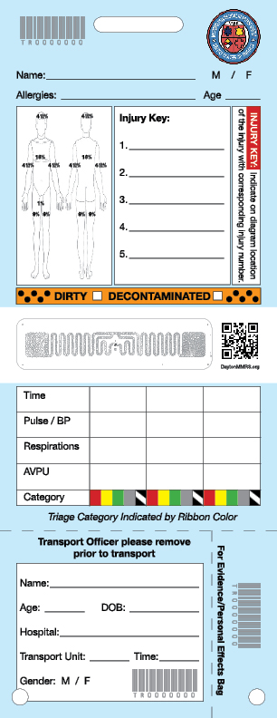
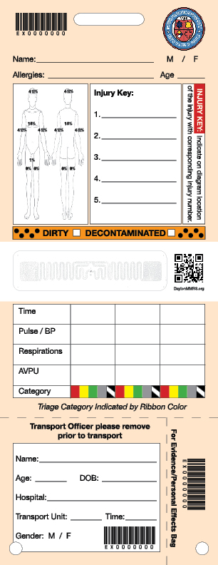

Slide 13
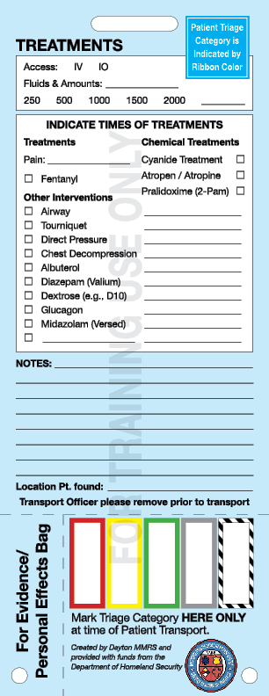
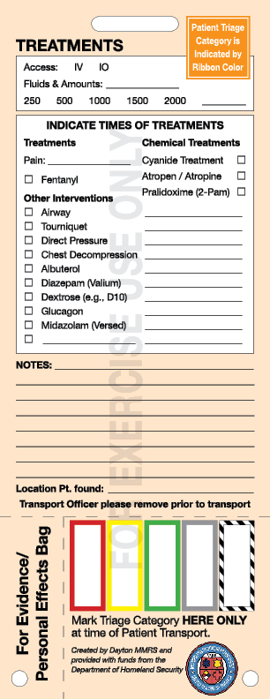

Slide 14
DAYTON MMRS TRIAGE MATERIALS
Three versions of Triage Tags:
“Live” tags:
Expensive
White
Synthetic paper
Bar codes, numbers, & RFID tags
Hospitals can use the bar code or the RFID tags but the viewable tag number matches the bar code, not the RFID

Slide 15
DAYTON MMRS TRIAGE MATERIALS
White Triage Tags:
Only for “real world” use:
Actual MCIs

Slide 16
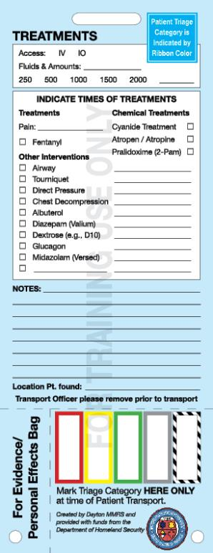
DAYTON MMRS TRIAGE MATERIALS
Three versions of Triage Tags:
Training tags:
Printed on blue background on cardstock
“For Training Use Only” watermark
No bar codes, numbers, or RFID tags.
Intended to be used for “Triage Tuesdays” and other drills
Inexpensive
Available in quantities from Dayton MMRS and county EMAs

Slide 17
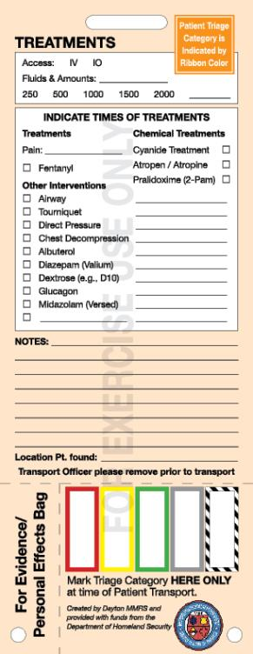
DAYTON MMRS TRIAGE MATERIALS
Three versions of Triage Tags:
Exercise tags:
Printed on orange background on cardstock
“For Exercise Use Only” watermark
Exercise tags have bar codes, numbers, and RFID tags
Intended to be used for significant exercises where simulated patients will actually be transported to hospitals
Available from Dayton MMRS

Slide 18
DAYTON MMRS TRIAGE MATERIALS
Three versions of Triage Tags:
Each EMA will have a supply of Training Triage tags and extra ribbon rolls
Do not use “Live” Triage Tags for training or exercises
Training Tags for training!

Slide 19
Using Dayton MMRS Triage Materials:
Triage Ribbon Kits

Slide 20
DAYTON MMRS TRIAGE RIBBON KIT

Slide 21
Triage Ribbons
Triage Ribbon is principal indication of the patient’s category
Triage Ribbon used later to attach the Triage Tag
Leave fairly long tails on each patient’s ribbon
Attach ribbons on right wrist, if possible

Slide 22
Ribbons & tags
Use Ribbons to attach the Tags
If Triage Category changes:
change the ribbon!
But keep the same Tag

Slide 23
DAYTON MMRS TRIAGE RIBBON KIT
Two storage compartments plus a glove pocket
Materials not supplied by MMRS, but pockets can hold LSIs up to:
Four CAT tourniquets
Four chest decompression needles
Four Combat Dressings
Four NPA
Gloves

Slide 25
DAYTON MMRS TRIAGE RIBBON KIT
Initial triage is indicated by the color-coded triage ribbons. Use the same ribbons to tie the Triage Tag to the patient.

Slide 26
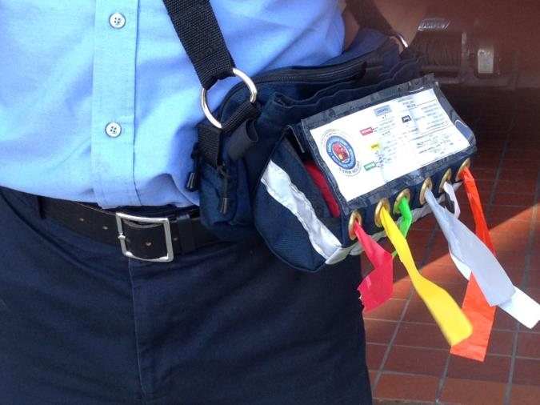
Ribbon Colors Match ID-MED Triage Categories
Immediate
Delayed
Minimal
Expectant
Dead
(Ribbon/Tag zebra-striped)
Notes:
The answers to these questions will allow you to place the patient in one of the 5 categories shown here. Each category is given a color code so that they can be recognized quickly.

Slide 27
DAYTON MMRS TRIAGE RIBBON KIT
Sixth color ribbon is Orange for contaminated patients
Has dots to distinguish from red ribbons
Contaminated patients initially get two ribbons (orange plus category color)
Remove orange ribbon once patient decon’ed, but mark on Triage Tag

Slide 28
Using Dayton MMRS Triage Materials:
Triage Tags

Slide 30
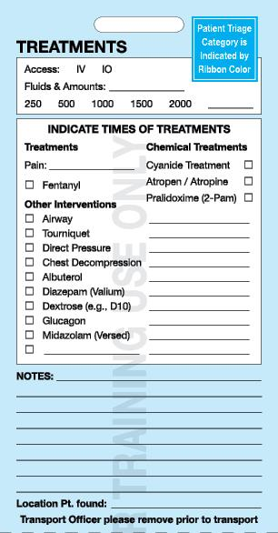

Slide 31
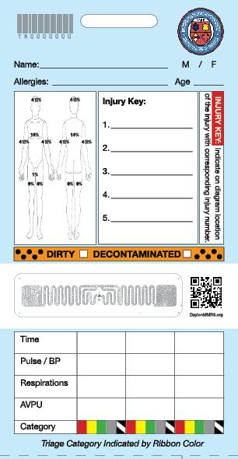

Slide 34
Burns
1

Slide 43
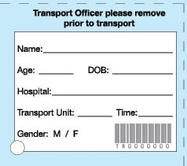

Slide 46
Using Dayton MMRS Triage Materials:
Transport Log

Slide 48
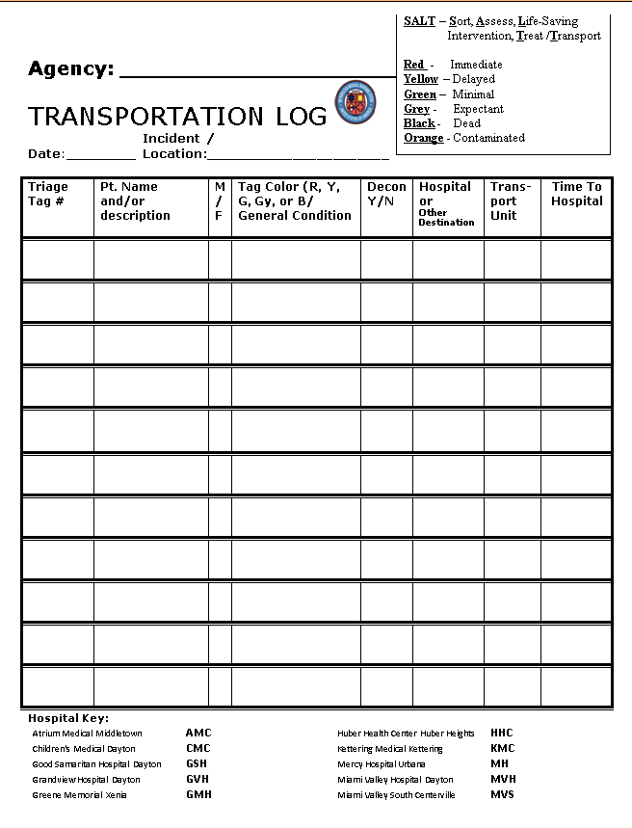

Slide 51
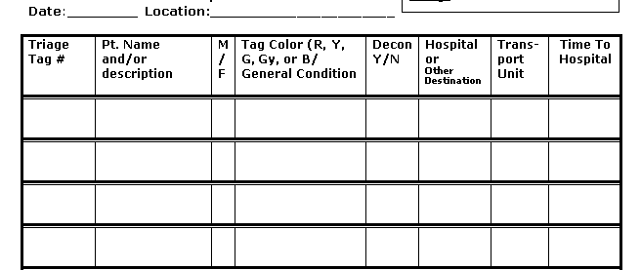

Slide 56
Using Dayton MMRS Triage Materials:
Transport Worksheet

Slide 57
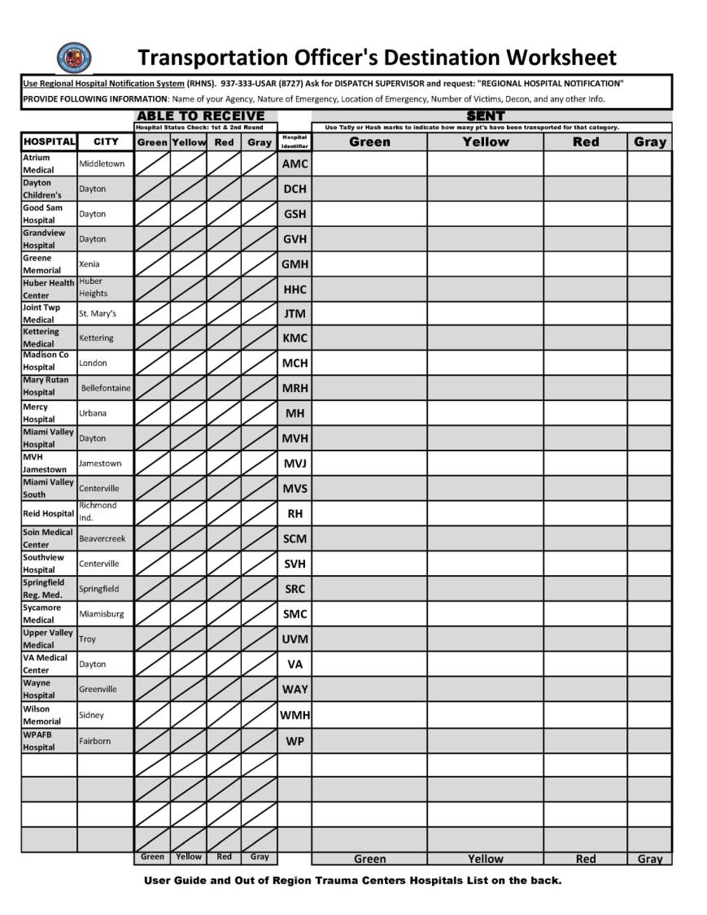

Slide 60
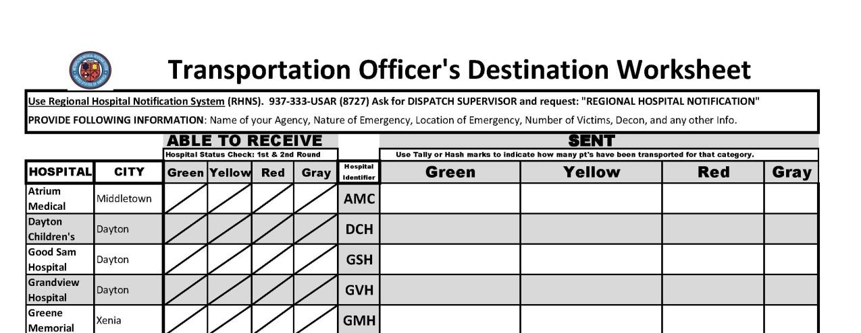

Slide 67
Using Dayton MMRS Triage Materials:
Additional Training

Slide 68
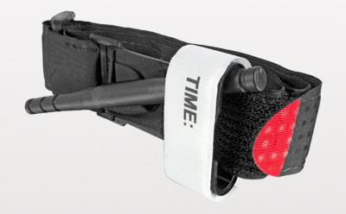
Dayton MMRS Triage Materials

Slide 69
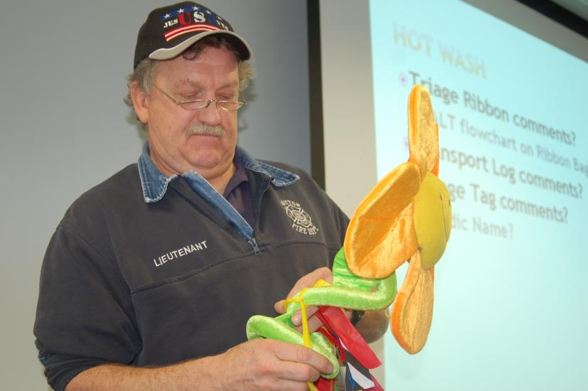
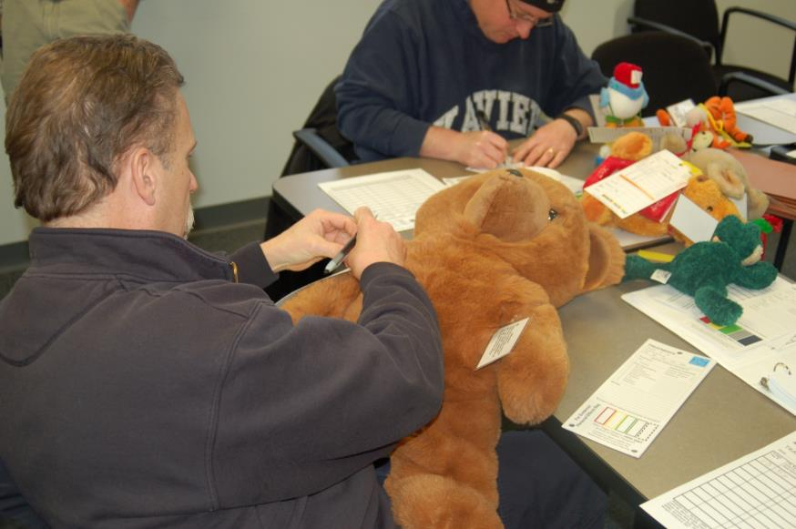
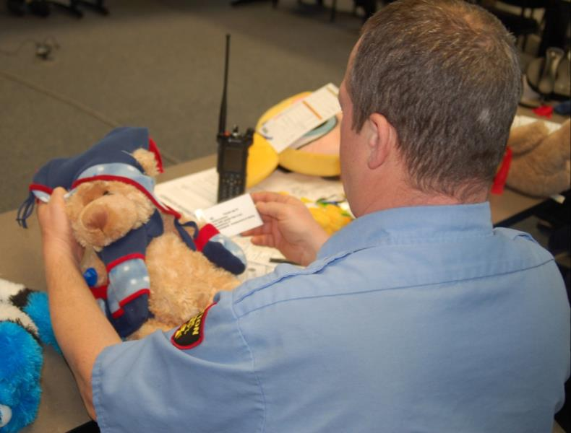

Slide 70
Training – Use Blue Tags, but Real Ribbons!

Slide 71
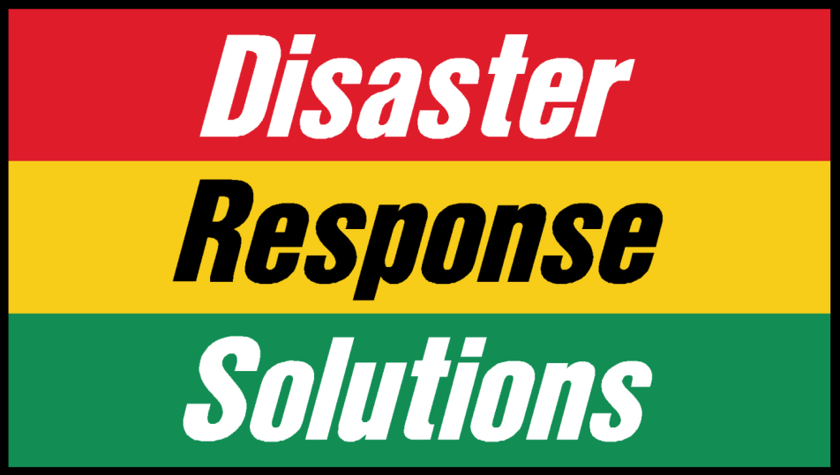
www.mcitrailer.com

Slide 72
Dayton MMRS Triage Materials
More information on SALT and Triage Materials at:
www.DaytonMMRS.org
www.GMVEMSC.org

