Slide 1



2019-2020
Standing Orders
FOCUSED UPDATE with emphasis on modalities frequently missed from the 2018-2019 CBT!
As of: 3-10-19

Slide 2

GMVEMSC PREHOSPITAL PARAMEDIC STANDING ORDERS
TRAINING MANUAL VERSION June 1, 2019
Adult: Patients 16 Years Old and Above
Pediatric: Patients < 16 Years old will be in Pink and Bulleted with a “P”
ADULT and PEDIATRIC ORDERS INDEX
Frequently MISSED EMR Questions from last years CBT…
Areas where the questions came from:
  Narcan (pg. 49)
  Newborn care (pg. 25)
  Flail chest (pg. 16)
  Oxygen administration pg. 10)
  Tourniquets (pg. 17)
Notes:
Peds airway – preferred airway device?
Poisoning – Need advice? Who do you call?
Trauma Centers – Does a trauma patient ALWAYS HAVE to go to a trauma center?
Cardiac - ACLS treatable causes.
Excited Delirium in arrest.
Newborn suctioning?
Sepsis – MAP.
Stroke – capabilities of facilities.

Slide 3
GMVEMSC PREHOSPITAL PARAMEDIC STANDING ORDERS
TRAINING MANUAL VERSION June 1, 2019
Adult: Patients 16 Years Old and Above
Pediatric: Patients < 16 Years old will be in Pink and Bulleted with a “P”
ADULT and PEDIATRIC ORDERS INDEX
Frequently MISSED EMT Questions from last years CBT…
Areas where the questions came from:
  Pediatric airway (pg. 9)
  Nitroglycerine administration (pg. 12)
  EpiPen dosing (pg. 27)
  Frostbite care (pg. 24)
  Pregnancy transports (pg. 30)
  Extremity fractures (pg. 23)
  Spinal Motion Restriction (pg. 7)
  CPAP is used (pg. 27)
  Narcan dosing (pg. 56)
Notes:
Peds airway – preferred airway device?
Poisoning – Need advice? Who do you call?
Trauma Centers – Does a trauma patient ALWAYS HAVE to go to a trauma center?
Cardiac - ACLS treatable causes.
Excited Delirium in arrest.
Newborn suctioning?
Sepsis – MAP.
Stroke – capabilities of facilities.

Slide 4
GMVEMSC PREHOSPITAL PARAMEDIC STANDING ORDERS
TRAINING MANUAL VERSION June 1, 2019
Adult: Patients 16 Years Old and Above
Pediatric: Patients < 16 Years old will be in Pink and Bulleted with a “P”
ADULT and PEDIATRIC ORDERS INDEX
Frequently MISSED AEMT Questions from last years CBT…
Areas where the questions came from:
  Glucagon (pg. 35)
  Pediatric airway (pg. 10)
  Rescue airways (pg. 10)
  Nitroglycerine administration (pg. 75)
  Poisoning (pg. 38)
  Infants with fevers (pg. 43)
  Heat exposure (pg. 33)
  Cyanide poisoning
  Trauma Centers (pg. 23)
  Terminating a cardiac arrest (pg. 25)
  Sepsis (pg. 21)
  Fentanyl dosing (pg. 69)
  Flail chest (pg. 29)
  Crush syndrome (pg. 61)
  Newborn care (pg. 25)
  Non-traumatic shock (pg. 20)
Notes:
Peds airway – preferred airway device?
Poisoning – Need advice? Who do you call?
Trauma Centers – Does a trauma patient ALWAYS HAVE to go to a trauma center?
Cardiac - ACLS treatable causes.
Excited Delirium in arrest.
Newborn suctioning?
Sepsis – MAP.
Stroke – capabilities of facilities.

Slide 5
GMVEMSC PREHOSPITAL PARAMEDIC STANDING ORDERS
TRAINING MANUAL VERSION June 1, 2019
Adult: Patients 16 Years Old and Above
Pediatric: Patients < 16 Years old will be in Pink and Bulleted with a “P”
ADULT and PEDIATRIC ORDERS INDEX
Frequently MISSED Paramedic Questions from last years CBT…
Areas where the questions came from:
  Pediatric airway (pg. 10)
  Poisoning (pg. 41)
  Trauma Centers (pg. 25)
  Cardiac (ACLS reversible causes) (pg. 17)
  Excited Delirium (pg. 50)
  Newborn Care (pg. 45)
  Sepsis (pg. 23)
  Stroke (pg. 24)
  Nitroglycerine administration (pg. 19)
  Heat exposure (pg. 35)
  Fentanyl dosing (pg. 9)
  Terminating (pg. 27)
Notes:
Peds airway – preferred airway device?
Poisoning – Need advice? Who do you call?
Trauma Centers – Does a trauma patient ALWAYS HAVE to go to a trauma center?
Cardiac - ACLS treatable causes.
Excited Delirium in arrest.
Newborn suctioning?
Sepsis – MAP.
Stroke – capabilities of facilities.

Slide 6
GMVEMSC PREHOSPITAL PARAMEDIC STANDING ORDERS
TRAINING MANUAL VERSION June 1, 2019
Adult: Patients 16 Years Old and Above
Pediatric: Patients < 16 Years old will be in Pink and Bulleted with a “P”
ADULT and PEDIATRIC ORDERS INDEX
This is the TRAINING MANUAL for the actual PROTOCOL. All questions for the CBT are taken from these pages…
GMVEMSC
PREHOSPITAL STANDING ORDERS
TRAINING MANUAL VERSION
June 1, 2019
Adult: Patients 16 Years Old and Above
Pediatric: Patients < 16 Years old will be in Pink and Bulleted with a “P”
PEDIATRIC
Patients are LESS THAN 16 Years old
This PowerPoint provides a FOCUSED UPDATE to the 2018 GMVEMSC STANDING ORDERS
Included are areas of the GMVEMSC Protocols that were frequently missed from the 2018 CBT.

Slide 7

GMVEMSC PREHOSPITAL PARAMEDIC STANDING ORDERS
TRAINING MANUAL VERSION June 1, 2019
Adult: Patients 16 Years Old and Above
Pediatric: Patients < 16 Years old will be in Pink and Bulleted with a “P”
ADULT and PEDIATRIC ORDERS INDEX
2019 STIPULATIONS
This protocol is for use by those individuals operating in and under the authority of the Greater Miami Valley EMS Council (GMVEMSC) Drug Bag Exchange Program and certified by the State of Ohio as a Paramedic. You may not use new protocol until you have passed both the skills check-off and CBT.
This protocol is to be used in the field only. Communications must be attempted as soon as practical for potentially unstable patients, or for hospitals that request contact on all patients being transferred to their facility.
Procedures marked with a diamond (♦) are never to be performed without a physician's order. The diamond provides identification of procedures and medications that require on-line medical control authorization.
No procedures, techniques, or drugs will be used without the proper equipment or beyond the training or capabilities of the prehospital personnel. Nothing in this protocol may be used without specific pre-approval of the Medical Director for the local department or agency.
It is the recommendation of the Standing Orders Committee that departments be able to access the humeral head via IO in the adult population.
It is recommended to use filtered needles when drawing up any medication from an ampule.
Items enclosed in braces ({ }) are at the option of the department and its Medical Director.
EMS personnel of any level are not authorized to intubate, unless they have and can use appropriate confirmation devices: End tidal carbon dioxide (EtCO₂) detectors or monitors, or Esophageal Detection Devices (EDD).
Any patient in respiratory distress on oxygen or whose O₂ sats indicate a need for oxygen, shall remain on oxygen until care is transferred to the hospital.
Any patient being monitored for a significant cardiac event or EtCO₂ shall remain on the monitor until patient care is transferred to hospital staff. In addition, a summary report shall be provided from any device capable of printing one.
Infrequently, stepwise adherence to specific protocols may not be in the patient’s best interest. No protocol can substitute for the EMS professional’s judgment. However, at no time should treatment options exceed those authorized without direct consultation with the Medical Control Physician (MCP). In all such cases, contact with MCP should be considered as soon as possible.
The Adult and Pediatric Orders (“Peds”) are combined.
Sections that apply only to Adults are bulleted with an “A”.
All Pediatric treatments will be in Pink and bulleted with a “P”.
Sections which apply to both Adult and Peds are indicated with standard bullets.
G There are also sections which apply to only Geriatric patients and are bulleted with a bold “G.”

Slide 8
GMVEMSC PREHOSPITAL PARAMEDIC STANDING ORDERS
TRAINING MANUAL VERSION June 1, 2019
Adult: Patients 16 Years Old and Above
Pediatric: Patients < 16 Years old will be in Pink and Bulleted with a “P”
ADULT and PEDIATRIC ORDERS INDEX
{
This protocol is for use by those individuals operating in and under the authority of the Greater Miami Valley EMS Council (GMVEMSC) Drug Bag Exchange Program and certified by the State of Ohio as a Paramedic. You may not use new protocol until you have passed both the skills check-off and CBT.
2019 STIPULATIONS
This protocol is for use by those individuals operating in and under the authority of the Greater Miami Valley EMS Council (GMVEMSC) Drug Bag Exchange Program and certified by the State of Ohio as a Paramedic. You may not use new protocol until you have passed both the skills check-off and CBT.
This protocol is to be used in the field only. Communications must be attempted as soon as practical for potentially unstable patients, or for hospitals that request contact on all patients being transferred to their facility.
Procedures marked with a diamond (♦) are never to be performed without a physician's order. The diamond provides identification of procedures and medications that require on-line medical control authorization.
No procedures, techniques, or drugs will be used without the proper equipment or beyond the training or capabilities of the prehospital personnel. Nothing in this protocol may be used without specific pre-approval of the Medical Director for the local department or agency.
It is the recommendation of the Standing Orders Committee that departments be able to access the humeral head via IO in the adult population.
It is recommended to use filtered needles when drawing up any medication from an ampule.
Items enclosed in braces ({ }) are at the option of the department and its Medical Director.
EMS personnel of any level are not authorized to intubate, unless they have and can use appropriate confirmation devices: End tidal carbon dioxide (EtCO₂) detectors or monitors, or Esophageal Detection Devices (EDD).
Any patient in respiratory distress on oxygen or whose O₂ sats indicate a need for oxygen, shall remain on oxygen until care is transferred to the hospital.
Any patient being monitored for a significant cardiac event or EtCO₂ shall remain on the monitor until patient care is transferred to hospital staff. In addition, a summary report shall be provided from any device capable of printing one.
Infrequently, stepwise adherence to specific protocols may not be in the patient’s best interest. No protocol can substitute for the EMS professional’s judgment. However, at no time should treatment options exceed those authorized without direct consultation with the Medical Control Physician (MCP). In all such cases, contact with MCP should be considered as soon as possible.
The Adult and Pediatric Orders (“Peds”) are combined.
Sections that apply only to Adults are bulleted with an “A”.
All Pediatric treatments will be in Pink and bulleted with a “P”.
Sections which apply to both Adult and Peds are indicated with standard bullets.
G There are also sections which apply to only Geriatric patients and are bulleted with a bold “G.”

Slide 9
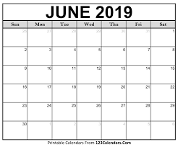

GMVEMSC PREHOSPITAL PARAMEDIC STANDING ORDERS
TRAINING MANUAL VERSION June 1, 2019
Adult: Patients 16 Years Old and Above
Pediatric: Patients < 16 Years old will be in Pink and Bulleted with a “P”
ADULT and PEDIATRIC ORDERS INDEX
Please Remember!
The 2019 Protocol takes effect at 0000 hours on 1 June, 2019.
and
can ONLY be used if you’ve passed your 2019 CBT and Skills testing.
(Including OPTIONAL SKILLS)

Slide 10
GMVEMSC PREHOSPITAL PARAMEDIC STANDING ORDERS
TRAINING MANUAL VERSION June 1, 2019
Adult: Patients 16 Years Old and Above
Pediatric: Patients < 16 Years old will be in Pink and Bulleted with a “P”
ADULT and PEDIATRIC ORDERS INDEX
{
2019 STIPULATIONS
This protocol is for use by those individuals operating in and under the authority of the Greater Miami Valley EMS Council (GMVEMSC) Drug Bag Exchange Program and certified by the State of Ohio as a Paramedic. You may not use new protocol until you have passed both the skills check-off and CBT.
This protocol is to be used in the field only. Communications must be attempted as soon as practical for potentially unstable patients, or for hospitals that request contact on all patients being transferred to their facility.
Procedures marked with a diamond (♦) are never to be performed without a physician's order. The diamond provides identification of procedures and medications that require on-line medical control authorization.
No procedures, techniques, or drugs will be used without the proper equipment or beyond the training or capabilities of the prehospital personnel. Nothing in this protocol may be used without specific pre-approval of the Medical Director for the local department or agency.
It is the recommendation of the Standing Orders Committee that departments be able to access the humeral head via IO in the adult population.
It is recommended to use filtered needles when drawing up any medication from an ampule.
Items enclosed in braces ({ }) are at the option of the department and its Medical Director.
EMS personnel of any level are not authorized to intubate, unless they have and can use appropriate confirmation devices: End tidal carbon dioxide (EtCO₂) detectors or monitors, or Esophageal Detection Devices (EDD).
Any patient in respiratory distress on oxygen or whose O₂ sats indicate a need for oxygen, shall remain on oxygen until care is transferred to the hospital.
Any patient being monitored for a significant cardiac event or EtCO₂ shall remain on the monitor until patient care is transferred to hospital staff. In addition, a summary report shall be provided from any device capable of printing one.
Infrequently, stepwise adherence to specific protocols may not be in the patient’s best interest. No protocol can substitute for the EMS professional’s judgment. However, at no time should treatment options exceed those authorized without direct consultation with the Medical Control Physician (MCP). In all such cases, contact with MCP should be considered as soon as possible.
The Adult and Pediatric Orders (“Peds”) are combined.
Sections that apply only to Adults are bulleted with an “A”.
All Pediatric treatments will be in Pink and bulleted with a “P”.
Sections which apply to both Adult and Peds are indicated with standard bullets.
G There are also sections which apply to only Geriatric patients and are bulleted with a bold “G.”
This protocol is to be used in the field only. Communications must be attempted as soon as practical for potentially unstable patients, or for hospitals that request contact on all patients being transferred to their facility.

Slide 11
GMVEMSC PREHOSPITAL PARAMEDIC STANDING ORDERS
TRAINING MANUAL VERSION June 1, 2019
Adult: Patients 16 Years Old and Above
Pediatric: Patients < 16 Years old will be in Pink and Bulleted with a “P”
ADULT and PEDIATRIC ORDERS INDEX
2019 STIPULATIONS
This protocol is for use by those individuals operating in and under the authority of the Greater Miami Valley EMS Council (GMVEMSC) Drug Bag Exchange Program and certified by the State of Ohio as a Paramedic. You may not use new protocol until you have passed both the skills check-off and CBT.
This protocol is to be used in the field only. Communications must be attempted as soon as practical for potentially unstable patients, or for hospitals that request contact on all patients being transferred to their facility.
Procedures marked with a diamond (♦) are never to be performed without a physician's order. The diamond provides identification of procedures and medications that require on-line medical control authorization.
No procedures, techniques, or drugs will be used without the proper equipment or beyond the training or capabilities of the prehospital personnel. Nothing in this protocol may be used without specific pre-approval of the Medical Director for the local department or agency.
It is the recommendation of the Standing Orders Committee that departments be able to access the humeral head via IO in the adult population.
It is recommended to use filtered needles when drawing up any medication from an ampule.
Items enclosed in braces ({ }) are at the option of the department and its Medical Director.
EMS personnel of any level are not authorized to intubate, unless they have and can use appropriate confirmation devices: End tidal carbon dioxide (EtCO₂) detectors or monitors, or Esophageal Detection Devices (EDD).
Any patient in respiratory distress on oxygen or whose O₂ sats indicate a need for oxygen, shall remain on oxygen until care is transferred to the hospital.
Any patient being monitored for a significant cardiac event or EtCO₂ shall remain on the monitor until patient care is transferred to hospital staff. In addition, a summary report shall be provided from any device capable of printing one.
Infrequently, stepwise adherence to specific protocols may not be in the patient’s best interest. No protocol can substitute for the EMS professional’s judgment. However, at no time should treatment options exceed those authorized without direct consultation with the Medical Control Physician (MCP). In all such cases, contact with MCP should be considered as soon as possible.
The Adult and Pediatric Orders (“Peds”) are combined.
Sections that apply only to Adults are bulleted with an “A”.
All Pediatric treatments will be in Pink and bulleted with a “P”.
Sections which apply to both Adult and Peds are indicated with standard bullets.
G There are also sections which apply to only Geriatric patients and are bulleted with a bold “G.”
{
Procedures marked with a diamond (♦) are never to be performed without a physician's order. The diamond provides identification of procedures and medications that require on-line medical control authorization.
♦or♦

Slide 12
GMVEMSC PREHOSPITAL PARAMEDIC STANDING ORDERS
TRAINING MANUAL VERSION June 1, 2019
Adult: Patients 16 Years Old and Above
Pediatric: Patients < 16 Years old will be in Pink and Bulleted with a “P”
ADULT and PEDIATRIC ORDERS INDEX
2019 STIPULATIONS
This protocol is for use by those individuals operating in and under the authority of the Greater Miami Valley EMS Council (GMVEMSC) Drug Bag Exchange Program and certified by the State of Ohio as a Paramedic. You may not use new protocol until you have passed both the skills check-off and CBT.
This protocol is to be used in the field only. Communications must be attempted as soon as practical for potentially unstable patients, or for hospitals that request contact on all patients being transferred to their facility.
Procedures marked with a diamond (♦) are never to be performed without a physician's order. The diamond provides identification of procedures and medications that require on-line medical control authorization.
No procedures, techniques, or drugs will be used without the proper equipment or beyond the training or capabilities of the prehospital personnel. Nothing in this protocol may be used without specific pre-approval of the Medical Director for the local department or agency.
It is the recommendation of the Standing Orders Committee that departments be able to access the humeral head via IO in the adult population.
It is recommended to use filtered needles when drawing up any medication from an ampule.
Items enclosed in braces ({ }) are at the option of the department and its Medical Director.
EMS personnel of any level are not authorized to intubate, unless they have and can use appropriate confirmation devices: End tidal carbon dioxide (EtCO₂) detectors or monitors, or Esophageal Detection Devices (EDD).
Any patient in respiratory distress on oxygen or whose O₂ sats indicate a need for oxygen, shall remain on oxygen until care is transferred to the hospital.
Any patient being monitored for a significant cardiac event or EtCO₂ shall remain on the monitor until patient care is transferred to hospital staff. In addition, a summary report shall be provided from any device capable of printing one.
Infrequently, stepwise adherence to specific protocols may not be in the patient’s best interest. No protocol can substitute for the EMS professional’s judgment. However, at no time should treatment options exceed those authorized without direct consultation with the Medical Control Physician (MCP). In all such cases, contact with MCP should be considered as soon as possible.
The Adult and Pediatric Orders (“Peds”) are combined.
Sections that apply only to Adults are bulleted with an “A”.
All Pediatric treatments will be in Pink and bulleted with a “P”.
Sections which apply to both Adult and Peds are indicated with standard bullets.
G There are also sections which apply to only Geriatric patients and are bulleted with a bold “G.”
{
No procedures, techniques, or drugs will be used without the proper equipment or beyond the training or capabilities of the prehospital personnel. Nothing in this protocol may be used without specific pre-approval of the Medical Director for the local department or agency.

Slide 13
GMVEMSC PREHOSPITAL PARAMEDIC STANDING ORDERS
TRAINING MANUAL VERSION June 1, 2019
Adult: Patients 16 Years Old and Above
Pediatric: Patients < 16 Years old will be in Pink and Bulleted with a “P”
ADULT and PEDIATRIC ORDERS INDEX
2019 STIPULATIONS
This protocol is for use by those individuals operating in and under the authority of the Greater Miami Valley EMS Council (GMVEMSC) Drug Bag Exchange Program and certified by the State of Ohio as a Paramedic. You may not use new protocol until you have passed both the skills check-off and CBT.
This protocol is to be used in the field only. Communications must be attempted as soon as practical for potentially unstable patients, or for hospitals that request contact on all patients being transferred to their facility.
Procedures marked with a diamond (♦) are never to be performed without a physician's order. The diamond provides identification of procedures and medications that require on-line medical control authorization.
No procedures, techniques, or drugs will be used without the proper equipment or beyond the training or capabilities of the prehospital personnel. Nothing in this protocol may be used without specific pre-approval of the Medical Director for the local department or agency.
It is the recommendation of the Standing Orders Committee that departments be able to access the humeral head via IO in the adult population.
It is recommended to use filtered needles when drawing up any medication from an ampule.
Items enclosed in braces ({ }) are at the option of the department and its Medical Director.
EMS personnel of any level are not authorized to intubate, unless they have and can use appropriate confirmation devices: End tidal carbon dioxide (EtCO₂) detectors or monitors, or Esophageal Detection Devices (EDD).
Any patient in respiratory distress on oxygen or whose O₂ sats indicate a need for oxygen, shall remain on oxygen until care is transferred to the hospital.
Any patient being monitored for a significant cardiac event or EtCO₂ shall remain on the monitor until patient care is transferred to hospital staff. In addition, a summary report shall be provided from any device capable of printing one.
Infrequently, stepwise adherence to specific protocols may not be in the patient’s best interest. No protocol can substitute for the EMS professional’s judgment. However, at no time should treatment options exceed those authorized without direct consultation with the Medical Control Physician (MCP). In all such cases, contact with MCP should be considered as soon as possible.
The Adult and Pediatric Orders (“Peds”) are combined.
Sections that apply only to Adults are bulleted with an “A”.
All Pediatric treatments will be in Pink and bulleted with a “P”.
Sections which apply to both Adult and Peds are indicated with standard bullets.
G There are also sections which apply to only Geriatric patients and are bulleted with a bold “G.”
{
It is the recommendation of the Standing Orders Committee that departments be able to access the humeral head via IO in the adult population.

Slide 14
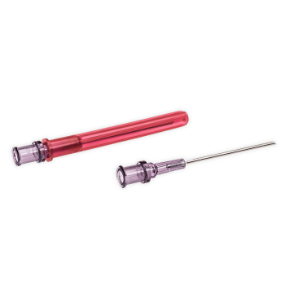
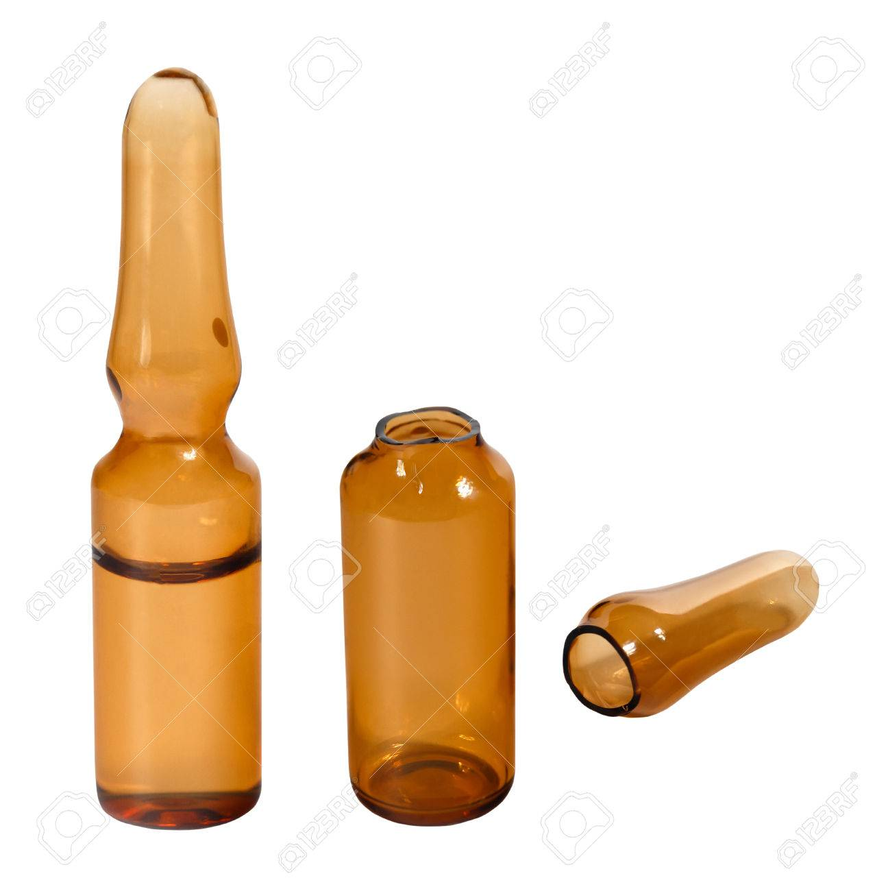
GMVEMSC PREHOSPITAL PARAMEDIC STANDING ORDERS
TRAINING MANUAL VERSION June 1, 2019
Adult: Patients 16 Years Old and Above
Pediatric: Patients < 16 Years old will be in Pink and Bulleted with a “P”
ADULT and PEDIATRIC ORDERS INDEX
2019 STIPULATIONS
This protocol is for use by those individuals operating in and under the authority of the Greater Miami Valley EMS Council (GMVEMSC) Drug Bag Exchange Program and certified by the State of Ohio as a Paramedic. You may not use new protocol until you have passed both the skills check-off and CBT.
This protocol is to be used in the field only. Communications must be attempted as soon as practical for potentially unstable patients, or for hospitals that request contact on all patients being transferred to their facility.
Procedures marked with a diamond (♦) are never to be performed without a physician's order. The diamond provides identification of procedures and medications that require on-line medical control authorization.
No procedures, techniques, or drugs will be used without the proper equipment or beyond the training or capabilities of the prehospital personnel. Nothing in this protocol may be used without specific pre-approval of the Medical Director for the local department or agency.
It is the recommendation of the Standing Orders Committee that departments be able to access the humeral head via IO in the adult population.
It is recommended to use filtered needles when drawing up any medication from an ampule.
Items enclosed in braces ({ }) are at the option of the department and its Medical Director.
EMS personnel of any level are not authorized to intubate, unless they have and can use appropriate confirmation devices: End tidal carbon dioxide (EtCO₂) detectors or monitors, or Esophageal Detection Devices (EDD).
Any patient in respiratory distress on oxygen or whose O₂ sats indicate a need for oxygen, shall remain on oxygen until care is transferred to the hospital.
Any patient being monitored for a significant cardiac event or EtCO₂ shall remain on the monitor until patient care is transferred to hospital staff. In addition, a summary report shall be provided from any device capable of printing one.
Infrequently, stepwise adherence to specific protocols may not be in the patient’s best interest. No protocol can substitute for the EMS professional’s judgment. However, at no time should treatment options exceed those authorized without direct consultation with the Medical Control Physician (MCP). In all such cases, contact with MCP should be considered as soon as possible.
The Adult and Pediatric Orders (“Peds”) are combined.
Sections that apply only to Adults are bulleted with an “A”.
All Pediatric treatments will be in Pink and bulleted with a “P”.
Sections which apply to both Adult and Peds are indicated with standard bullets.
G There are also sections which apply to only Geriatric patients and are bulleted with a bold “G.”
{
It is recommended to use filtered needles when drawing up any medication from an ampule.

Slide 15
GMVEMSC PREHOSPITAL PARAMEDIC STANDING ORDERS
TRAINING MANUAL VERSION June 1, 2019
Adult: Patients 16 Years Old and Above
Pediatric: Patients < 16 Years old will be in Pink and Bulleted with a “P”
ADULT and PEDIATRIC ORDERS INDEX
{ }
2019 STIPULATIONS
This protocol is for use by those individuals operating in and under the authority of the Greater Miami Valley EMS Council (GMVEMSC) Drug Bag Exchange Program and certified by the State of Ohio as a Paramedic. You may not use new protocol until you have passed both the skills check-off and CBT.
This protocol is to be used in the field only. Communications must be attempted as soon as practical for potentially unstable patients, or for hospitals that request contact on all patients being transferred to their facility.
Procedures marked with a diamond (♦) are never to be performed without a physician's order. The diamond provides identification of procedures and medications that require on-line medical control authorization.
No procedures, techniques, or drugs will be used without the proper equipment or beyond the training or capabilities of the prehospital personnel. Nothing in this protocol may be used without specific pre-approval of the Medical Director for the local department or agency.
It is the recommendation of the Standing Orders Committee that departments be able to access the humeral head via IO in the adult population.
It is recommended to use filtered needles when drawing up any medication from an ampule.
Items enclosed in braces ({ }) are at the option of the department and its Medical Director.
EMS personnel of any level are not authorized to intubate, unless they have and can use appropriate confirmation devices: End tidal carbon dioxide (EtCO₂) detectors or monitors, or Esophageal Detection Devices (EDD).
Any patient in respiratory distress on oxygen or whose O₂ sats indicate a need for oxygen, shall remain on oxygen until care is transferred to the hospital.
Any patient being monitored for a significant cardiac event or EtCO₂ shall remain on the monitor until patient care is transferred to hospital staff. In addition, a summary report shall be provided from any device capable of printing one.
Infrequently, stepwise adherence to specific protocols may not be in the patient’s best interest. No protocol can substitute for the EMS professional’s judgment. However, at no time should treatment options exceed those authorized without direct consultation with the Medical Control Physician (MCP). In all such cases, contact with MCP should be considered as soon as possible.
The Adult and Pediatric Orders (“Peds”) are combined.
Sections that apply only to Adults are bulleted with an “A”.
All Pediatric treatments will be in Pink and bulleted with a “P”.
Sections which apply to both Adult and Peds are indicated with standard bullets.
G There are also sections which apply to only Geriatric patients and are bulleted with a bold “G.”
{
Items enclosed in braces ({ }) are at the option of the department and its Medical Director.
  If OPTIONAL SKILLS are authorized by your AGENCY MEDICAL DIRECTOR they MUST be TESTED at your agencies ANNUAL SKILLS EVALUATIONS.
  OPTIONAL SKILLS include:
    Acquisition & transmission of 12-Lead ECG’s
    ALS Assist skills for EMT’s
    Cardiac Alert
    Morgan Lens
    Rapid Sequence Intubation (RSI)
    Sedate to Intubate (STI)
    Waveform ETCO₂

Slide 16
GMVEMSC PREHOSPITAL PARAMEDIC STANDING ORDERS
TRAINING MANUAL VERSION June 1, 2019
Adult: Patients 16 Years Old and Above
Pediatric: Patients < 16 Years old will be in Pink and Bulleted with a “P”
ADULT and PEDIATRIC ORDERS INDEX
2019 STIPULATIONS
This protocol is for use by those individuals operating in and under the authority of the Greater Miami Valley EMS Council (GMVEMSC) Drug Bag Exchange Program and certified by the State of Ohio as a Paramedic. You may not use new protocol until you have passed both the skills check-off and CBT.
This protocol is to be used in the field only. Communications must be attempted as soon as practical for potentially unstable patients, or for hospitals that request contact on all patients being transferred to their facility.
Procedures marked with a diamond (♦) are never to be performed without a physician's order. The diamond provides identification of procedures and medications that require on-line medical control authorization.
No procedures, techniques, or drugs will be used without the proper equipment or beyond the training or capabilities of the prehospital personnel. Nothing in this protocol may be used without specific pre-approval of the Medical Director for the local department or agency.
It is the recommendation of the Standing Orders Committee that departments be able to access the humeral head via IO in the adult population.
It is recommended to use filtered needles when drawing up any medication from an ampule.
Items enclosed in braces ({ }) are at the option of the department and its Medical Director.
EMS personnel of any level are not authorized to intubate, unless they have and can use appropriate confirmation devices: End tidal carbon dioxide (EtCO₂) detectors or monitors, or Esophageal Detection Devices (EDD).
Any patient in respiratory distress on oxygen or whose O₂ sats indicate a need for oxygen, shall remain on oxygen until care is transferred to the hospital.
Any patient being monitored for a significant cardiac event or EtCO₂ shall remain on the monitor until patient care is transferred to hospital staff. In addition, a summary report shall be provided from any device capable of printing one.
Infrequently, stepwise adherence to specific protocols may not be in the patient’s best interest. No protocol can substitute for the EMS professional’s judgment. However, at no time should treatment options exceed those authorized without direct consultation with the Medical Control Physician (MCP). In all such cases, contact with MCP should be considered as soon as possible.
The Adult and Pediatric Orders (“Peds”) are combined.
Sections that apply only to Adults are bulleted with an “A”.
All Pediatric treatments will be in Pink and bulleted with a “P”.
Sections which apply to both Adult and Peds are indicated with standard bullets.
G There are also sections which apply to only Geriatric patients and are bulleted with a bold “G.”
{
EMS personnel of any level are not authorized to intubate, unless they have and can use appropriate confirmation devices: End tidal carbon dioxide (EtCO₂) detectors or monitors, or Esophageal Detection Devices (EDD).

Slide 17
Ohio DPS EMS
WAVEFORM CAPNOGRAPHY REQUIREMENT
GMVEMSC PREHOSPITAL PARAMEDIC STANDING ORDERS
TRAINING MANUAL VERSION June 1, 2019
Adult: Patients 16 Years Old and Above
Pediatric: Patients < 16 Years old will be in Pink and Bulleted with a “P”
ADULT and PEDIATRIC ORDERS INDEX
Regarding the Use of Capnometry and Capnography for Patients in the Prehospital Setting February 2015
“The ventilatory assessment of all patients, particularly those requiring invasive airway devices, is critical. In the interest of patient safety, the EMFTS Board highly recommends the utilization of digital capnometry or waveform capnography as an assessment tool for all patients who require oxygen via any route of administration”.
Effective January 1, 2021, WAVEFORM CAPNOGRAPHY is required for all patients requiring invasive airway devices.
  “As continuous patient monitoring is preferred, the EMFTS Board, on December 17, 2014, approved the mandatory utilization of waveform capnography for all patients requiring invasive airway devices effective January 1, 2021”.
    Click HERE to learn more about the requirement.
  Ohio DPS EMS Priority 1 training and equipment grants are available to assist with acquisition.
    EMFTS = Emergency Medical, Fire, and Transportation Services Board

Slide 18
GMVEMSC PREHOSPITAL PARAMEDIC STANDING ORDERS
TRAINING MANUAL VERSION June 1, 2019
Adult: Patients 16 Years Old and Above
Pediatric: Patients < 16 Years old will be in Pink and Bulleted with a “P”
ADULT and PEDIATRIC ORDERS INDEX
2019 STIPULATIONS
This protocol is for use by those individuals operating in and under the authority of the Greater Miami Valley EMS Council (GMVEMSC) Drug Bag Exchange Program and certified by the State of Ohio as a Paramedic. You may not use new protocol until you have passed both the skills check-off and CBT.
This protocol is to be used in the field only. Communications must be attempted as soon as practical for potentially unstable patients, or for hospitals that request contact on all patients being transferred to their facility.
Procedures marked with a diamond (♦) are never to be performed without a physician's order. The diamond provides identification of procedures and medications that require on-line medical control authorization.
No procedures, techniques, or drugs will be used without the proper equipment or beyond the training or capabilities of the prehospital personnel. Nothing in this protocol may be used without specific pre-approval of the Medical Director for the local department or agency.
It is the recommendation of the Standing Orders Committee that departments be able to access the humeral head via IO in the adult population.
It is recommended to use filtered needles when drawing up any medication from an ampule.
Items enclosed in braces ({ }) are at the option of the department and its Medical Director.
EMS personnel of any level are not authorized to intubate, unless they have and can use appropriate confirmation devices: End tidal carbon dioxide (EtCO₂) detectors or monitors, or Esophageal Detection Devices (EDD).
Any patient in respiratory distress on oxygen or whose O₂ sats indicate a need for oxygen, shall remain on oxygen until care is transferred to the hospital.
Any patient being monitored for a significant cardiac event or EtCO₂ shall remain on the monitor until patient care is transferred to hospital staff. In addition, a summary report shall be provided from any device capable of printing one.
Infrequently, stepwise adherence to specific protocols may not be in the patient’s best interest. No protocol can substitute for the EMS professional’s judgment. However, at no time should treatment options exceed those authorized without direct consultation with the Medical Control Physician (MCP). In all such cases, contact with MCP should be considered as soon as possible.
The Adult and Pediatric Orders (“Peds”) are combined.
Sections that apply only to Adults are bulleted with an “A”.
All Pediatric treatments will be in Pink and bulleted with a “P”.
Sections which apply to both Adult and Peds are indicated with standard bullets.
G There are also sections which apply to only Geriatric patients and are bulleted with a bold “G.”
{
Any patient in respiratory distress on oxygen or whose O₂ sats indicate a need for oxygen, shall remain on oxygen until care is transferred to the hospital.

Slide 19
GMVEMSC PREHOSPITAL PARAMEDIC STANDING ORDERS
TRAINING MANUAL VERSION June 1, 2019
Adult: Patients 16 Years Old and Above
Pediatric: Patients < 16 Years old will be in Pink and Bulleted with a “P”
ADULT and PEDIATRIC ORDERS INDEX
2019 STIPULATIONS
This protocol is for use by those individuals operating in and under the authority of the Greater Miami Valley EMS Council (GMVEMSC) Drug Bag Exchange Program and certified by the State of Ohio as a Paramedic. You may not use new protocol until you have passed both the skills check-off and CBT.
This protocol is to be used in the field only. Communications must be attempted as soon as practical for potentially unstable patients, or for hospitals that request contact on all patients being transferred to their facility.
Procedures marked with a diamond (♦) are never to be performed without a physician's order. The diamond provides identification of procedures and medications that require on-line medical control authorization.
No procedures, techniques, or drugs will be used without the proper equipment or beyond the training or capabilities of the prehospital personnel. Nothing in this protocol may be used without specific pre-approval of the Medical Director for the local department or agency.
It is the recommendation of the Standing Orders Committee that departments be able to access the humeral head via IO in the adult population.
It is recommended to use filtered needles when drawing up any medication from an ampule.
Items enclosed in braces ({ }) are at the option of the department and its Medical Director.
EMS personnel of any level are not authorized to intubate, unless they have and can use appropriate confirmation devices: End tidal carbon dioxide (EtCO₂) detectors or monitors, or Esophageal Detection Devices (EDD).
Any patient in respiratory distress on oxygen or whose O₂ sats indicate a need for oxygen, shall remain on oxygen until care is transferred to the hospital.
Any patient being monitored for a significant cardiac event or EtCO₂ shall remain on the monitor until patient care is transferred to hospital staff. In addition, a summary report shall be provided from any device capable of printing one.
Infrequently, stepwise adherence to specific protocols may not be in the patient’s best interest. No protocol can substitute for the EMS professional’s judgment. However, at no time should treatment options exceed those authorized without direct consultation with the Medical Control Physician (MCP). In all such cases, contact with MCP should be considered as soon as possible.
The Adult and Pediatric Orders (“Peds”) are combined.
Sections that apply only to Adults are bulleted with an “A”.
All Pediatric treatments will be in Pink and bulleted with a “P”.
Sections which apply to both Adult and Peds are indicated with standard bullets.
G There are also sections which apply to only Geriatric patients and are bulleted with a bold “G.”
{
Any patient being monitored for a significant cardiac event or EtCO₂ shall remain on the monitor until patient care is transferred to hospital staff. In addition, a summary report shall be provided from any device capable of printing one.

Slide 20
GMVEMSC PREHOSPITAL PARAMEDIC STANDING ORDERS
TRAINING MANUAL VERSION June 1, 2019
Adult: Patients 16 Years Old and Above
Pediatric: Patients < 16 Years old will be in Pink and Bulleted with a “P”
ADULT and PEDIATRIC ORDERS INDEX
2019 STIPULATIONS
This protocol is for use by those individuals operating in and under the authority of the Greater Miami Valley EMS Council (GMVEMSC) Drug Bag Exchange Program and certified by the State of Ohio as a Paramedic. You may not use new protocol until you have passed both the skills check-off and CBT.
This protocol is to be used in the field only. Communications must be attempted as soon as practical for potentially unstable patients, or for hospitals that request contact on all patients being transferred to their facility.
Procedures marked with a diamond (♦) are never to be performed without a physician's order. The diamond provides identification of procedures and medications that require on-line medical control authorization.
No procedures, techniques, or drugs will be used without the proper equipment or beyond the training or capabilities of the prehospital personnel. Nothing in this protocol may be used without specific pre-approval of the Medical Director for the local department or agency.
It is the recommendation of the Standing Orders Committee that departments be able to access the humeral head via IO in the adult population.
It is recommended to use filtered needles when drawing up any medication from an ampule.
Items enclosed in braces ({ }) are at the option of the department and its Medical Director.
EMS personnel of any level are not authorized to intubate, unless they have and can use appropriate confirmation devices: End tidal carbon dioxide (EtCO₂) detectors or monitors, or Esophageal Detection Devices (EDD).
Any patient in respiratory distress on oxygen or whose O₂ sats indicate a need for oxygen, shall remain on oxygen until care is transferred to the hospital.
Any patient being monitored for a significant cardiac event or EtCO₂ shall remain on the monitor until patient care is transferred to hospital staff. In addition, a summary report shall be provided from any device capable of printing one.
Infrequently, stepwise adherence to specific protocols may not be in the patient’s best interest. No protocol can substitute for the EMS professional’s judgment. However, at no time should treatment options exceed those authorized without direct consultation with the Medical Control Physician (MCP). In all such cases, contact with MCP should be considered as soon as possible.
The Adult and Pediatric Orders (“Peds”) are combined.
Sections that apply only to Adults are bulleted with an “A”.
All Pediatric treatments will be in Pink and bulleted with a “P”.
Sections which apply to both Adult and Peds are indicated with standard bullets.
G There are also sections which apply to only Geriatric patients and are bulleted with a bold “G.”
{
Infrequently, stepwise adherence to specific protocols may not be in the patient’s best interest. No protocol can substitute for the EMS professional’s judgment. However, at no time should treatment options exceed those authorized without direct consultation with the Medical Control Physician (MCP). In all such cases, contact with MCP should be considered as soon as possible.

Slide 21
GMVEMSC PREHOSPITAL PARAMEDIC STANDING ORDERS
TRAINING MANUAL VERSION June 1, 2019
Adult: Patients 16 Years Old and Above
Pediatric: Patients < 16 Years old will be in Pink and Bulleted with a “P”
ADULT and PEDIATRIC ORDERS INDEX
OAC 4765-14-02 Determination of a trauma victim defines the ages of pediatric, adult, and geriatric.
2019 STIPULATIONS
This protocol is for use by those individuals operating in and under the authority of the Greater Miami Valley EMS Council (GMVEMSC) Drug Bag Exchange Program and certified by the State of Ohio as a Paramedic. You may not use new protocol until you have passed both the skills check-off and CBT.
This protocol is to be used in the field only. Communications must be attempted as soon as practical for potentially unstable patients, or for hospitals that request contact on all patients being transferred to their facility.
Procedures marked with a diamond (♦) are never to be performed without a physician's order. The diamond provides identification of procedures and medications that require on-line medical control authorization.
No procedures, techniques, or drugs will be used without the proper equipment or beyond the training or capabilities of the prehospital personnel. Nothing in this protocol may be used without specific pre-approval of the Medical Director for the local department or agency.
It is the recommendation of the Standing Orders Committee that departments be able to access the humeral head via IO in the adult population.
It is recommended to use filtered needles when drawing up any medication from an ampule.
Items enclosed in braces ({ }) are at the option of the department and its Medical Director.
EMS personnel of any level are not authorized to intubate, unless they have and can use appropriate confirmation devices: End tidal carbon dioxide (EtCO₂) detectors or monitors, or Esophageal Detection Devices (EDD).
Any patient in respiratory distress on oxygen or whose O₂ sats indicate a need for oxygen, shall remain on oxygen until care is transferred to the hospital.
Any patient being monitored for a significant cardiac event or EtCO₂ shall remain on the monitor until patient care is transferred to hospital staff. In addition, a summary report shall be provided from any device capable of printing one.
Infrequently, stepwise adherence to specific protocols may not be in the patient’s best interest. No protocol can substitute for the EMS professional’s judgment. However, at no time should treatment options exceed those authorized without direct consultation with the Medical Control Physician (MCP). In all such cases, contact with MCP should be considered as soon as possible.
The Adult and Pediatric Orders (“Peds”) are combined.
Sections that apply only to Adults are bulleted with an “A”.
All Pediatric treatments will be in Pink and bulleted with a “P”.
Sections which apply to both Adult and Peds are indicated with standard bullets.
G There are also sections which apply to only Geriatric patients and are bulleted with a bold “G.”
What are they?
PEDIATRIC =
<16
GERIATRIC =
70+
ADULT =
16-69
{
The Adult and Pediatric Orders (“Peds”) are combined.

Slide 22
GMVEMSC PREHOSPITAL PARAMEDIC STANDING ORDERS
TRAINING MANUAL VERSION June 1, 2019
Adult: Patients 16 Years Old and Above
Pediatric: Patients < 16 Years old will be in Pink and Bulleted with a “P”
ADULT and PEDIATRIC ORDERS INDEX
2019 STIPULATIONS
This protocol is for use by those individuals operating in and under the authority of the Greater Miami Valley EMS Council (GMVEMSC) Drug Bag Exchange Program and certified by the State of Ohio as a Paramedic. You may not use new protocol until you have passed both the skills check-off and CBT.
This protocol is to be used in the field only. Communications must be attempted as soon as practical for potentially unstable patients, or for hospitals that request contact on all patients being transferred to their facility.
Procedures marked with a diamond (♦) are never to be performed without a physician's order. The diamond provides identification of procedures and medications that require on-line medical control authorization.
No procedures, techniques, or drugs will be used without the proper equipment or beyond the training or capabilities of the prehospital personnel. Nothing in this protocol may be used without specific pre-approval of the Medical Director for the local department or agency.
It is the recommendation of the Standing Orders Committee that departments be able to access the humeral head via IO in the adult population.
It is recommended to use filtered needles when drawing up any medication from an ampule.
Items enclosed in braces ({ }) are at the option of the department and its Medical Director.
EMS personnel of any level are not authorized to intubate, unless they have and can use appropriate confirmation devices: End tidal carbon dioxide (EtCO₂) detectors or monitors, or Esophageal Detection Devices (EDD).
Any patient in respiratory distress on oxygen or whose O₂ sats indicate a need for oxygen, shall remain on oxygen until care is transferred to the hospital.
Any patient being monitored for a significant cardiac event or EtCO₂ shall remain on the monitor until patient care is transferred to hospital staff. In addition, a summary report shall be provided from any device capable of printing one.
Infrequently, stepwise adherence to specific protocols may not be in the patient’s best interest. No protocol can substitute for the EMS professional’s judgment. However, at no time should treatment options exceed those authorized without direct consultation with the Medical Control Physician (MCP). In all such cases, contact with MCP should be considered as soon as possible.
The Adult and Pediatric Orders (“Peds”) are combined.
Sections that apply only to Adults are bulleted with an “A”.
All Pediatric treatments will be in Pink and bulleted with a “P”.
Sections which apply to both Adult and Peds are indicated with standard bullets.
G There are also sections which apply to only Geriatric patients and are bulleted with a bold “G.”
A
{
Sections that apply only to Adults are bulleted with an “A”.

Slide 23
GMVEMSC PREHOSPITAL PARAMEDIC STANDING ORDERS
TRAINING MANUAL VERSION June 1, 2019
Adult: Patients 16 Years Old and Above
Pediatric: Patients < 16 Years old will be in Pink and Bulleted with a “P”
ADULT and PEDIATRIC ORDERS INDEX
2019 STIPULATIONS
This protocol is for use by those individuals operating in and under the authority of the Greater Miami Valley EMS Council (GMVEMSC) Drug Bag Exchange Program and certified by the State of Ohio as a Paramedic. You may not use new protocol until you have passed both the skills check-off and CBT.
This protocol is to be used in the field only. Communications must be attempted as soon as practical for potentially unstable patients, or for hospitals that request contact on all patients being transferred to their facility.
Procedures marked with a diamond (♦) are never to be performed without a physician's order. The diamond provides identification of procedures and medications that require on-line medical control authorization.
No procedures, techniques, or drugs will be used without the proper equipment or beyond the training or capabilities of the prehospital personnel. Nothing in this protocol may be used without specific pre-approval of the Medical Director for the local department or agency.
It is the recommendation of the Standing Orders Committee that departments be able to access the humeral head via IO in the adult population.
It is recommended to use filtered needles when drawing up any medication from an ampule.
Items enclosed in braces ({ }) are at the option of the department and its Medical Director.
EMS personnel of any level are not authorized to intubate, unless they have and can use appropriate confirmation devices: End tidal carbon dioxide (EtCO₂) detectors or monitors, or Esophageal Detection Devices (EDD).
Any patient in respiratory distress on oxygen or whose O₂ sats indicate a need for oxygen, shall remain on oxygen until care is transferred to the hospital.
Any patient being monitored for a significant cardiac event or EtCO₂ shall remain on the monitor until patient care is transferred to hospital staff. In addition, a summary report shall be provided from any device capable of printing one.
Infrequently, stepwise adherence to specific protocols may not be in the patient’s best interest. No protocol can substitute for the EMS professional’s judgment. However, at no time should treatment options exceed those authorized without direct consultation with the Medical Control Physician (MCP). In all such cases, contact with MCP should be considered as soon as possible.
The Adult and Pediatric Orders (“Peds”) are combined.
Sections that apply only to Adults are bulleted with an “A”.
All Pediatric treatments will be in Pink and bulleted with a “P”.
Sections which apply to both Adult and Peds are indicated with standard bullets.
G There are also sections which apply to only Geriatric patients and are bulleted with a bold “G.”
P
{
All Pediatric treatments will be in Pink and bulleted with a “P”.

Slide 24
GMVEMSC PREHOSPITAL PARAMEDIC STANDING ORDERS
TRAINING MANUAL VERSION June 1, 2019
Adult: Patients 16 Years Old and Above
Pediatric: Patients < 16 Years old will be in Pink and Bulleted with a “P”
ADULT and PEDIATRIC ORDERS INDEX
2019 STIPULATIONS
This protocol is for use by those individuals operating in and under the authority of the Greater Miami Valley EMS Council (GMVEMSC) Drug Bag Exchange Program and certified by the State of Ohio as a Paramedic. You may not use new protocol until you have passed both the skills check-off and CBT.
This protocol is to be used in the field only. Communications must be attempted as soon as practical for potentially unstable patients, or for hospitals that request contact on all patients being transferred to their facility.
Procedures marked with a diamond (♦) are never to be performed without a physician's order. The diamond provides identification of procedures and medications that require on-line medical control authorization.
No procedures, techniques, or drugs will be used without the proper equipment or beyond the training or capabilities of the prehospital personnel. Nothing in this protocol may be used without specific pre-approval of the Medical Director for the local department or agency.
It is the recommendation of the Standing Orders Committee that departments be able to access the humeral head via IO in the adult population.
It is recommended to use filtered needles when drawing up any medication from an ampule.
Items enclosed in braces ({ }) are at the option of the department and its Medical Director.
EMS personnel of any level are not authorized to intubate, unless they have and can use appropriate confirmation devices: End tidal carbon dioxide (EtCO₂) detectors or monitors, or Esophageal Detection Devices (EDD).
Any patient in respiratory distress on oxygen or whose O₂ sats indicate a need for oxygen, shall remain on oxygen until care is transferred to the hospital.
Any patient being monitored for a significant cardiac event or EtCO₂ shall remain on the monitor until patient care is transferred to hospital staff. In addition, a summary report shall be provided from any device capable of printing one.
Infrequently, stepwise adherence to specific protocols may not be in the patient’s best interest. No protocol can substitute for the EMS professional’s judgment. However, at no time should treatment options exceed those authorized without direct consultation with the Medical Control Physician (MCP). In all such cases, contact with MCP should be considered as soon as possible.
The Adult and Pediatric Orders (“Peds”) are combined.
Sections that apply only to Adults are bulleted with an “A”.
All Pediatric treatments will be in Pink and bulleted with a “P”.
Sections which apply to both Adult and Peds are indicated with standard bullets.
G There are also sections which apply to only Geriatric patients and are bulleted with a bold “G.”

{
Sections which apply to both Adult and Peds are indicated with standard bullets.

Slide 25
GMVEMSC PREHOSPITAL PARAMEDIC STANDING ORDERS
TRAINING MANUAL VERSION June 1, 2019
Adult: Patients 16 Years Old and Above
Pediatric: Patients < 16 Years old will be in Pink and Bulleted with a “P”
ADULT and PEDIATRIC ORDERS INDEX
2019 STIPULATIONS
This protocol is for use by those individuals operating in and under the authority of the Greater Miami Valley EMS Council (GMVEMSC) Drug Bag Exchange Program and certified by the State of Ohio as a Paramedic. You may not use new protocol until you have passed both the skills check-off and CBT.
This protocol is to be used in the field only. Communications must be attempted as soon as practical for potentially unstable patients, or for hospitals that request contact on all patients being transferred to their facility.
Procedures marked with a diamond (♦) are never to be performed without a physician's order. The diamond provides identification of procedures and medications that require on-line medical control authorization.
No procedures, techniques, or drugs will be used without the proper equipment or beyond the training or capabilities of the prehospital personnel. Nothing in this protocol may be used without specific pre-approval of the Medical Director for the local department or agency.
It is the recommendation of the Standing Orders Committee that departments be able to access the humeral head via IO in the adult population.
It is recommended to use filtered needles when drawing up any medication from an ampule.
Items enclosed in braces ({ }) are at the option of the department and its Medical Director.
EMS personnel of any level are not authorized to intubate, unless they have and can use appropriate confirmation devices: End tidal carbon dioxide (EtCO₂) detectors or monitors, or Esophageal Detection Devices (EDD).
Any patient in respiratory distress on oxygen or whose O₂ sats indicate a need for oxygen, shall remain on oxygen until care is transferred to the hospital.
Any patient being monitored for a significant cardiac event or EtCO₂ shall remain on the monitor until patient care is transferred to hospital staff. In addition, a summary report shall be provided from any device capable of printing one.
Infrequently, stepwise adherence to specific protocols may not be in the patient’s best interest. No protocol can substitute for the EMS professional’s judgment. However, at no time should treatment options exceed those authorized without direct consultation with the Medical Control Physician (MCP). In all such cases, contact with MCP should be considered as soon as possible.
The Adult and Pediatric Orders (“Peds”) are combined.
Sections that apply only to Adults are bulleted with an “A”.
All Pediatric treatments will be in Pink and bulleted with a “P”.
Sections which apply to both Adult and Peds are indicated with standard bullets.
G There are also sections which apply to only Geriatric patients and are bulleted with a bold “G.”
G
{
There are also sections which apply to only Geriatric patients and are bulleted with a bold “G.”

Slide 26
GMVEMSC PREHOSPITAL PARAMEDIC STANDING ORDERS
TRAINING MANUAL VERSION June 1, 2019
Adult: Patients 16 Years Old and Above
Pediatric: Patients < 16 Years old will be in Pink and Bulleted with a “P”
ADULT and PEDIATRIC ORDERS INDEX
PAGE 3
2018 NON-INITIATION OF CARE
NOTE: 1. ADULT & PEDIATRIC PATIENTS MAY MEET NON-INITIATION OF CARE CRITERIA.
2. If care began and it is readily apparent to EMS that the patient met non-initiation of care criteria, RESUSCITATION EFFORTS MAY CEASE.
Non-Initiation of Care
Resuscitation will not be initiated in the following circumstances:
  Deep, penetrating, cranial injuries
  Massive truncal wounds
  DNR Order—present and valid
  Frozen body
  Rigor mortis, tissue decomposition, or severe dependent lividity
  Triage demands
  Blunt trauma found in cardiac arrest unless one of the following conditions is present:
    Patient can be delivered to an emergency department within 5 minutes.
    The arrest is caused by a medical condition
    Focused blunt trauma to the chest (such as a baseball to the chest)
    An example is Commotio Cordis, a form of sudden cardiac death seen most often in boys and young men playing sports. It occurs as the result of a blunt, non-penetrating impact to the precordial region from a ball, bat or other projectile.
  Penetrating trauma found in cardiac arrest when the patient cannot be delivered to an emergency department within 15 minutes.
    Resuscitation will be initiated on victims of penetrating trauma who arrest after they are in EMS care.
Once en route, continue care even if the above time limits cannot be met.
Moved to page 27 and CHANGED
BLUNT or PENETRATING TRAUMA
Non-Initiation of Care
TIME LIMITS
HAVE BEEN REMOVED!
More later…






Slide 27
GMVEMSC PREHOSPITAL PARAMEDIC STANDING ORDERS
TRAINING MANUAL VERSION June 1, 2019
Adult: Patients 16 Years Old and Above
Pediatric: Patients < 16 Years old will be in Pink and Bulleted with a “P”
ADULT and PEDIATRIC ORDERS INDEX
PAGE 5 from 2018
2019 – DELETED
P. 5 Resuscitation Guidelines and Field Term was deleted and moved to page 28 under a new heading, Adult and Pediatric Trauma Arrest.

Slide 28
GMVEMSC PREHOSPITAL PARAMEDIC STANDING ORDERS
TRAINING MANUAL VERSION June 1, 2019
Adult: Patients 16 Years Old and Above
Pediatric: Patients < 16 Years old will be in Pink and Bulleted with a “P”
ADULT and PEDIATRIC ORDERS INDEX
PAGE 4
2018 DNR: COMFORT CARE and COMFORT CARE ARREST
Do Not Resuscitate-Comfort Care (DNR-CC)
Permits any medical treatment to diminish pain or discomfort that is not used to postpone the patient’s death.
The following treatments are permitted:
  Suctioning
  Oxygen
  Splinting/spinal restriction
  Bleeding control
  Pain control
  Or any intervention that will provide comfort
The following treatments are not permitted:
  Chest compressions
  Airway adjuncts including CPAP and respiratory assistance
  Resuscitative drugs
  Defibrillation, cardioversion, monitoring
Do Not Resuscitate-Comfort Care Arrest (DNR-CCA)
Permits any Standing Orders treatment until cardiac or respiratory arrest or agonal breathing occurs.
NOTE: EMS operates on a DNR status. A Living Will is not a DNR. A Living Will is for a long-term scenario.
Health Care Power of Attorney cannot revoke a DNR.
♦ Call MCP for any clarification.
2019 – DELETED
Health Care Power of Attorney cannot revoke a DNR.
(They can)


Slide 29


GMVEMSC PREHOSPITAL PARAMEDIC STANDING ORDERS
TRAINING MANUAL VERSION June 1, 2019
Adult: Patients 16 Years Old and Above
Pediatric: Patients < 16 Years old will be in Pink and Bulleted with a “P”
ADULT and PEDIATRIC ORDERS INDEX
KETAMINE
Ketamine 25 mg IV
May repeat 25 mg IV after 15 minutes
Unable to obtain IV:
Ketamine 25 mg IN or 50 mg IM
May repeat 25 mg IN or 50 mg IM after 15 minutes
FENTANYL
SBP Must be > 100
Fentanyl 50-100 mcg IV
May repeat 50-100 mcg after 15 minutes
Unable to obtain IV:
Fentanyl 50-100 mcg IN or IM
May repeat 50-100 mcg IN or IM after 15 minutes
  2019 – Page 9 Changed to:
Answer:
It compensates for what’s left behind in the syringe after injecting. This applies to all drawn up PEDS meds.
2019 PAIN CONTROL PROTOCOL
General Considerations
This protocol is for management of acute moderate to severe pain, including pain from suspected cardiac events, trauma, including thermal and chemical burns, crush syndrome, frostbite, fractures, dislocations, sprains, and abdominal pain including unilateral flank pain. It is not for the treatment of exacerbations of chronic pain. Prehospital pain management reduces time to pain relief, avoids exacerbation of pain during movement, is compassionate, and is good medical care. Document patient’s reported pain during initial patient contact, during treatment, and after any intervention. Use ice packs, position of comfort, and splinting to reduce pain as indicated. Always consider the weight of your patient when dosing pain meds, especially for the elderly.
For moderate to severe pain relief when the patient is alert give Fentanyl and/or Ketamine. Both meds may be given to the patient at the same time using the standard dosages.
♦ Call for orders if you feel narcotics are needed for pain from a chronic condition.
KETAMINE NOT TO BE ADMINISTERED TO ANYONE < 16 YEARS OF AGE FOR PAIN
FENTANYL IS NOT TO BE ADMINISTERED TO ANYONE < 2 YEARS OF AGE.
ADD AN ADDITIONAL 0.1 ML FENTANYL FOR PAIN FOR PEDS.
♦ MCP CONTACT REQUIRED BEFORE ADMINISTRATION OF FENTANYL FOR PEDIATRIC PATIENTS WITH ABDOMINAL PAIN.
Fentanyl IN, first choice
Fentanyl 1 mcg/kg IN, max 100 mcg
May repeat initial dose after 15 minutes
Fentanyl IV
SBP must be normal for age: (80 + 2 x age)
Fentanyl 1 mcg/kg IV, max 100 mcg
May repeat initial dose after 15 minutes
Fentanyl IM, LAST RESORT
Fentanyl 1 mcg/kg IM, max 100 mcg
May repeat initial dose after 15 minutes
What is another name for Fentanyl?
SUBLIMAZE
DO NOT GIVE KETAMINE TO SUSPECTED CARDIAC CHEST PAIN
Why?

Slide 30
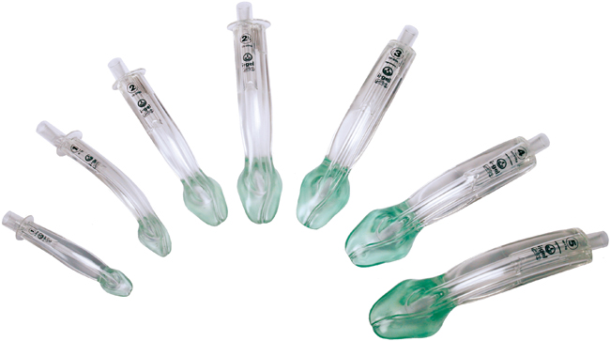
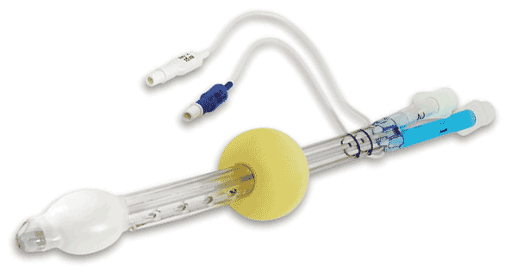
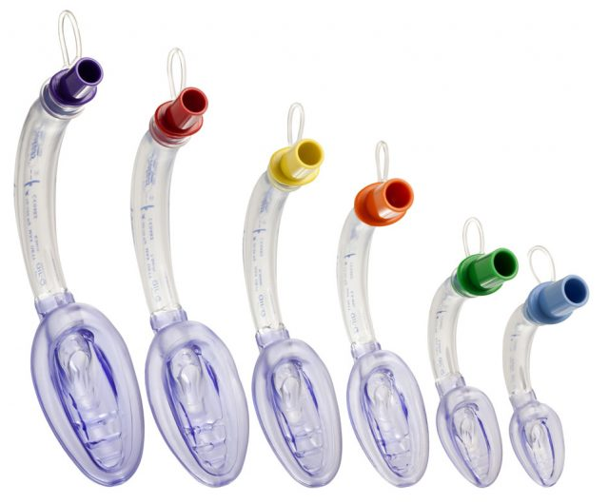
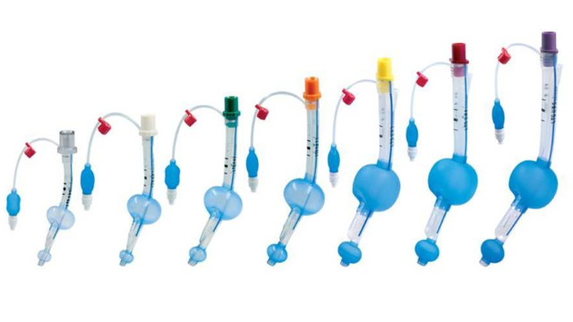
GMVEMSC PREHOSPITAL PARAMEDIC STANDING ORDERS
TRAINING MANUAL VERSION June 1, 2019
Adult: Patients 16 Years Old and Above
Pediatric: Patients < 16 Years old will be in Pink and Bulleted with a “P”
ADULT and PEDIATRIC ORDERS INDEX
2018 AIRWAY MAINTENANCE
O₂ as needed. Use the following rates as guidelines:
  2 LPM by nasal cannula (NC) for patient with COPD, or as prescribed.
  4-6 LPM by NC for other patients
  8-10 LPM for nebulized medications
  12-15 LPM by non-rebreather mask (NRM) for severe trauma patients, distressed cardiac patients, patients with respiratory distress, and other patients who need high flow O2.
Ventilate patients who are symptomatic with an insufficient respiratory rate or depth.
Consider patient airway anatomy for the appropriate selection of the airway adjunct.
If two attempts with an ETT are not successful, move to an adjunct device.
  If approved, adjuncts considered “rescue airways” such as the LMA or Dual Lumen Airways may be appropriate primary airway devices.
Supraglottic airway is recommended as the primary airway except in extreme cases such as airway edema.
When deciding whether to intubate, consider the following:
Insufficient respiratory rates, < 10 or > 29, that are not rapidly controlled by other measures
  Irregular respiratory rhythm
  Abnormal breath sounds
  Inadequate chest expansion and respiratory depth
  Excessive effort to breathe
  Use of accessory muscles
  Nasal flaring
  Pallor or cyanosis
  Cardiac dysrhythmias
Confirm correct placement of advanced airways by at least five methods.
For patient < 2 years old showing respiratory distress with nasal congestion, cough, rales, rhonchi or wheezing - without previous history of wheezing, reactive airway disease, breathing treatments: Nasal suction both nares (3-5 seconds) with an appropriate device and apply oxygen as required. If distress continues, repeat nasopharyngeal suction with an appropriately sized and lubricated suction catheter x 1, for 3-5 seconds.
NOTE: Repeated and prolonged suctioning could cause hypoxia and bradycardia.
If patient does have history of reactive airway disease with prescribed breathing treatments treat with asthma protocol.
For patients < 6 years old without a foreign body showing respiratory distress with agitation, upper airway noise, stridor, and/or “barky cough,” lower temperature of ambulance as much as possible. Use oxygen as the patient tolerates. Oftentimes symptoms resolve with less intervention. Consider keeping distance from the patient.
PAGE 10
SUPRAGLOTTIC AIRWAYS are NOT OPTIONAL.
The TYPE of SGA used is.
It is approved by your agency medical director and must be skill tested at least annually.
  2019 - Changed to:
If approved, adjuncts considered “rescue airways” such as the SUPRAGLOTTIC AIRWAY or Dual Lumen Airways may be appropriate primary airway devices.
RESPIRATORY RATES BY AGE
Up to 1 year | 30-60 | 7-9 years | 16-24
1-3 years | 20-40 | 10-14 years | 16-20
4-6 years | 20-30 | 15+ years | 12 -20

Slide 31
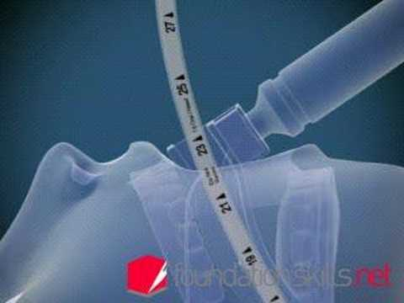
GMVEMSC PREHOSPITAL PARAMEDIC STANDING ORDERS
TRAINING MANUAL VERSION June 1, 2019
Adult: Patients 16 Years Old and Above
Pediatric: Patients < 16 Years old will be in Pink and Bulleted with a “P”
ADULT and PEDIATRIC ORDERS INDEX
≥8
2018 INTUBATION
Always secure the ET tube in place, preferably with a commercial tube-securing device.
A cervical collar is effective in maintaining patient’s head in a neutral position.
Reassess ET tube placement every time the patient is moved.
{Digital Intubation} or {Lighted Stylet Intubation} or {Camera Assisted} may be utilized.
{Dual Lumen Airways, (e.g., Combitube, Pharyngotracheal Lumen Airway (PtL)), King Airway, or Laryngeal Mask Airways (LMA)}, are acceptable airway devices and satisfy the “rescue airway” component for {StI}. Use of these devices is limited to patients who need an artificial airway, and who are able to tolerate the device.
If routine ventilation procedures are unsuccessful, try to visualize obstruction with laryngoscope. If a foreign body is seen, attempt to remove it using suction or Magill forceps.
If a conscious patient requires intubation, consider the following:
  Apply Lidocaine Jelly to the ET tube.
Lidocaine 100 mg IN (half dose per nostril) or nebulized with 8-10 LPM O₂.
  Lidocaine 1.5 mg/kg nebulized with 8-10 LPM O₂ or IN. Maximum dose is 100 mg.
If the patient is resisting the tube after confirmed intubation and SBP > 100, consider Midazolam 2 mg slow IV.
If SBP is appropriate, and the patient is resisting consider Midazolam 0.1 mg/kg (max dose 2 mg), slow IV.
If a patient would benefit from intubation but is combative, agitated, or has jaws clenched, use {Sedate to Intubate or RSI} procedures.
Whenever all reasonable attempts to provide an adequate airway by less invasive means have failed, perform a cricothyrotomy or surgical airway (must be ≥ 12 y/o) utilizing an approved method.
NOTE: Nebulized Lidocaine can be administered simultaneously with Albuterol and Ipratropium. If feasible, wait one to two minutes before intubating.
CONFIRMATION METHODS:
CO₂ detection methods are recommended and Capnography is the “gold standard.”
Auscultation of the epigastrium, anterior chest, midaxillary areas, and then the epigastrium again
Rise and fall of the chest
Repeat visualization of the tube between the vocal cords
Condensation in the tube
Depth placement and measurements:
  Keeping an oral endotracheal tube at the 20-22 cm mark at the teeth will prevent inserting the ETT too far and greatly reduces the chances of a right mainstem bronchus intubation. Don’t confuse right mainstem intubation for a pneumothorax.
Proper depth placement of tracheal tube in the pediatric patient can be calculated by the following formula: Depth of insertion (length of tube at teeth or gum line) = tube size x 3.
  A nasotracheal tube that is 22 cm at the nose is unlikely to reach the glottis.
PAGE 11
2019 – AGE & DEPTH CHANGES:
Whenever all reasonable attempts to provide an adequate airway by less invasive means have failed due to a total airway occlusion and you are unable to ventilate, perform a cricothyrotomy or surgical airway (must be ≥ 8 y/o) utilizing an approved method.
Depth placement and measurements:
Keeping an oral endotracheal tube at the 21-23 cm mark at the teeth will prevent inserting the ETT too far and greatly reduces the chances of a right mainstem bronchus intubation. Don’t confuse right mainstem intubation for a pneumothorax.
Please Note!
Needle Cricothyrotomy
and
Surgical Cricothyrotomy
ARE NOT
OPTIONAL SKILLS for Paramedics!
21-23 cm

Slide 32
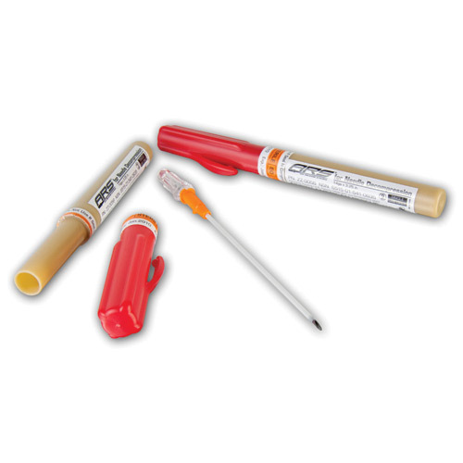
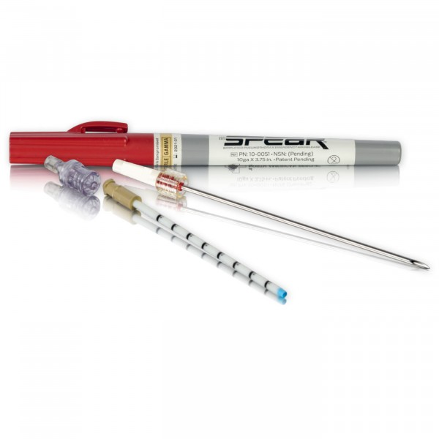
GMVEMSC PREHOSPITAL PARAMEDIC STANDING ORDERS
TRAINING MANUAL VERSION June 1, 2019
Adult: Patients 16 Years Old and Above
Pediatric: Patients < 16 Years old will be in Pink and Bulleted with a “P”
ADULT and PEDIATRIC ORDERS INDEX
PAGE 13
2019 - ADDED:
TENSION PNEUMOTHORAX RELIEF
If there are indications of tension pneumothorax and the patient is hemodynamically unstable, decompress the chest with a 14-gauge or larger, 3 ¼” angiocath placed in the second or third intercostal space in the mid-clavicular line (MCL). The MCL is parallel to the sternum, extending down from the midpoint of the clavicle. Placement of a needle too high, too low, too medial, or too lateral increases the risk of complications. Tracheal deviation is a very late sign and therefore an unreliable indicator.
3 ¼” angiocaths may not be available from emergency departments. EMS agencies may need to purchase them.
2018 TENSION PNEUMOTHORAX RELIEF
If there are indications of tension pneumothorax and the patient is hemodynamically unstable, decompress the chest with a 14-gauge, 3 ¼” angiocaths placed in the second or third intercostal space in the mid-clavicular line (MCL). The MCL is parallel to the sternum, extending down from the midpoint of the clavicle. Placement of a needle too high, too low, too medial, or too lateral increases the risk of complications. Tracheal deviation is a very late sign and therefore an unreliable indicator.
3 ¼” angiocaths may not be available from emergency departments. EMS agencies may need to purchase them.

Slide 33
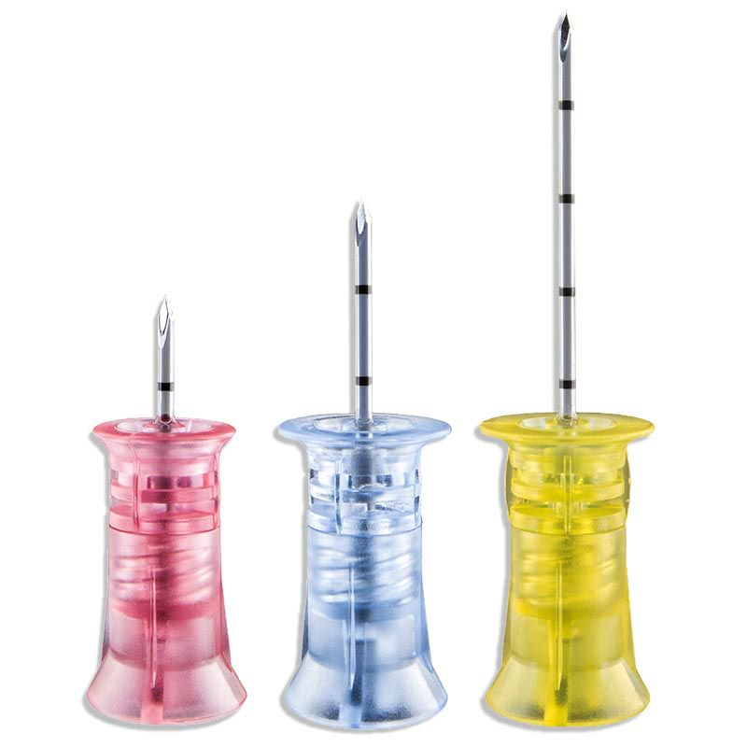
GMVEMSC PREHOSPITAL PARAMEDIC STANDING ORDERS
TRAINING MANUAL VERSION June 1, 2019
Adult: Patients 16 Years Old and Above
Pediatric: Patients < 16 Years old will be in Pink and Bulleted with a “P”
ADULT and PEDIATRIC ORDERS INDEX
PAGE 13 (continued)
2018 IO INSERTION
Use of IO devices is limited to patients who are unresponsive or hemodynamically unstable; and then, only when less invasive means are ineffective or not available (e.g., IM Glucagon, IN Narcan or Versed).
  For an adult in cardiac arrest, preferential order of vascular access is EJ, AC and proximal humeral IO. An adult cardiac arrest patient’s circulation differs from a pediatric cardiac arrest patient’s, and also differs from an adult in deep shock. With the approval of the department’s Medical Director, it is recommended that the proximal humerus be the site for IO insertions for adults in cardiac arrest. IV or IO accesses below the diaphragm may be ineffective for patients greater than 8 years old who are receiving CPR. Flow rates are better in the proximal humerus due to decreased bone density. The longer yellow (45 mm) needle should be used for humeral IOs in adults.
In summary:
2019 – ADDED
In summary: if all other routes have failed, along with bilateral proximal humerus failed attempts, then access proximal tibia.
 | Adults | Pediatric
Arrest: | Humerus | Tibia
Non-arrest: | Tibia | Tibia

Slide 34
GMVEMSC PREHOSPITAL PARAMEDIC STANDING ORDERS
TRAINING MANUAL VERSION June 1, 2019
Adult: Patients 16 Years Old and Above
Pediatric: Patients < 16 Years old will be in Pink and Bulleted with a “P”
ADULT and PEDIATRIC ORDERS INDEX
PAGE 14
2019 CHANGES / ADDED / REORDER:
Proximal Humerus
The greater tuberosity is located by placing the patient’s hand on their navel and relaxing their shoulder and elbow. Draw a straight line between the coracoid process and the acromion. Complete the drawing of a perfect triangle by using the previous line as the base of the triangle and extending the "point" of the triangle over the humeral head. The site is at the downward point of the triangle.
IO Insertion at Proximal Humerus
Position patient so shoulder is adducted (moved toward the middle of the body) and the greater tuberosity is most prominent by lying patient supine, arm at their side with palm on their navel.
Palpate proximal humerus and identify the greater tuberosity.
Prep the skin.
Insert the needle at a 45 degree angle to the frontal plane and aimed at the middle of the spine.
Needle will stand up on its own with proper placement.
In most patients, the longer yellow IO needle should be used for humeral IOs.
Attach syringe and aspirate bone marrow to further confirm placement.
Connect the IV line. If flow is good and extravasation is not evident, secure needle with gauze pads and tape.
Pressure bags may facilitate infusion.
A Lidocaine 2% 1.5 mg/kg up to 100 mg via IO for pain associated with infusion.
P Lidocaine 2% 0.5 mg/kg (max 100 mg) via IO for pain associated with IO infusion.
Proximal Tibia
Find the "flat spot" on the medial aspect of the tibial shaft two finger widths below (distal) the tibial tuberosity. Remember, "Big Toe IO" means to look on the big toe side of the leg for the tibial plateau (the flat spot). Use a similar technique as for the Pediatric tibial insertion.
Use the blue IO needle for 3-30 kg.
Use the pink IO needle for 0-3 kg.
IO Insertion at Proximal Tibia Site
Identify the tibial tuberosity by palpating just below the knee.
Locate the consistent flat area of bone 2 cm distal and slightly medial to the tibial tuberosity (to avoid growth plate).
Support flexed knee with towel under calf.
Prep the skin and insert needle according to manufacturer’s directions.
Use 10-15^{O} caudal angulation to further decrease risk of hitting growth plate.
Needle will stand up on its own with proper placement.
Attach syringe and aspirate bone marrow (to further confirm placement).
Connect the IV line. If flow is good and extravasation is not evident secure needle with gauze pads and tape.
A pressure bag may facilitate infusion.
A Lidocaine 2% 1.5 mg/kg up to 100 mg via IO for pain associated with infusion.
P Lidocaine 2% 0.5 mg/kg (max 100 mg) via IO for pain associated with IO infusion.
NOTE: The administration of other drug therapy should not be delayed due to the administration of Lidocaine for pain management.
2018
Proximal Tibia
Find the "flat spot" on the medial aspect of the tibial shaft two finger widths below (distal) the tibial tuberosity. Remember, "Big Toe IO" means to look on the big toe side of the leg for the tibial plateau (the flat spot). Use a similar technique as for the Pediatric tibial insertion.
Use the blue IO needle for 5-30 kg.
Use the pink IO needle for 0-5 kg.
IO Insertion at Proximal Tibia Site
Identify the tibial tuberosity by palpating just below the knee.
Locate the consistent flat area of bone 2 cm distal and slightly medial to the tibial tuberosity (to avoid growth plate).
Support flexed knee with towel under calf.
Prep the skin and insert needle according to manufacturer’s directions.
Use 10-15^{O} caudal angulation to further decrease risk of hitting growth plate.
Needle will stand up on its own with proper placement.
Attach syringe and aspirate bone marrow (to further confirm placement).
Connect the IV line. If flow is good and extravasation is not evident secure needle with gauze pads and tape.
A pressure bag may facilitate infusion.
Lidocaine 2% 1.5 mg/kg up to 100 mg via IO for pain associated with infusion.
Lidocaine 2% 0.5 mg/kg (max 100 mg) via IO for pain associated with IO infusion.
NOTE: The administration of other drug therapy should not be delayed due to the administration of Lidocaine for pain management.
Humeral Head
The greater tuberosity is located by placing the patient’s hand on their navel and relaxing their shoulder and elbow. Draw a straight line between the coracoid process and the acromion. Complete the drawing of a perfect triangle by using the previous line as the base of the triangle and extending the "point" of the triangle over the humeral head. The site is at the downward point of the triangle.
IO Insertion at Humeral Head Site
Position patient so shoulder is adducted (moved toward the middle of the body) and the greater tuberosity is most prominent by lying patient supine, arm at their side with palm on their navel.
Palpate proximal humerus and identify the greater tuberosity.
Prep the skin.
Insert the needle at a 45 degree angle to the frontal plane and aimed at the inferior portion of the sternum.
Needle will stand up on its own with proper placement.
In most patients, the longer yellow IO needle should be used for humeral IOs.
Attach syringe and aspirate bone marrow to further confirm placement.
Connect the IV line. If flow is good and extravasation is not evident, secure needle with gauze pads and tape.
Pressure bags may facilitate infusion.

Slide 35
GMVEMSC PREHOSPITAL PARAMEDIC STANDING ORDERS
TRAINING MANUAL VERSION June 1, 2019
Adult: Patients 16 Years Old and Above
Pediatric: Patients < 16 Years old will be in Pink and Bulleted with a “P”
ADULT and PEDIATRIC ORDERS INDEX
PAGE 18
2019 – CHANGED:
Resume chest compressions immediately following defibrillation, without performing pulse check, for 1-2 minutes
The importance of good CPR:
CPR is the foundation of the resuscitation arsenal.
High performance CPR improves the effectiveness of defibrillatory shock.
High performance CPR improves the effectiveness of medication treatments.
HQ-CPR - no matter how many responders are present, the following are always true:
C-A-B
Minimize interruptions in compressions
Compress at least 100/min but no more than 120/min
Allow complete chest wall recoil/decompression between compressions
Rhythm assessment every 2 minutes
Rotate compressors every 2 minutes
Hover over patient with hands ready during defibrillation so compressions can start immediately after the shock (or analysis) has occurred

Slide 36
GMVEMSC PREHOSPITAL PARAMEDIC STANDING ORDERS
TRAINING MANUAL VERSION June 1, 2019
Adult: Patients 16 Years Old and Above
Pediatric: Patients < 16 Years old will be in Pink and Bulleted with a “P”
ADULT and PEDIATRIC ORDERS INDEX
PAGE 19
2019 – CHANGES / ADDITIONS
SUSPECTED CARDIAC CHEST PAIN
      A patient with chest pain, whose oxygen sats are < 94%, should be given oxygen via NC and titrated to 94%.
      A patient with chest pain, whose oxygen sats are > 94%, should not get any oxygen.
      Do not withhold oxygen from a patient with SOB or respiratory distress.
      {Transmit} EKG with two identifiers to MCP. Name and DOB only must be written on any EKG left with a run report. Transmit any {12-lead EKG} that meets Cardiac Alert criteria, or that is questionable. If patient identifiers are not available, please obtain a hospital sticker from receiving facility and attach to EKG.
{
Should (verb)(def)
the past tense of shall : used as an auxiliary verb to indicate that an action is considered by the speaker to be obligatory, must.
{

Slide 37
GMVEMSC PREHOSPITAL PARAMEDIC STANDING ORDERS
TRAINING MANUAL VERSION June 1, 2019
Adult: Patients 16 Years Old and Above
Pediatric: Patients < 16 Years old will be in Pink and Bulleted with a “P”
ADULT and PEDIATRIC ORDERS INDEX
PAGE 24
LAST SEEN NORMAL or AWOKE ABNORMAL!
2018 STROKE
Be prepared to assist ventilations with oral or nasal airway and BVM or {FROPVD (Flow Restricted Oxygen Powered Ventilation Device)}.
A patient in respiratory distress with pale, moist skin and altered mental status, should get oxygen via NRM.
If signs of cerebral herniation are present, ventilate at the following rates:
  {If numeric EtCO₂ readings are available, ventilate at a rate to maintain readings at approximately 30 mmHg (30 torr)}, which is approximately 20 times per minute.
Ventilate at a rate of ten faster than normal respiratory rate when the signs of cerebral herniation are present.
If glucose < 60, or there is strong suspicion of hypoglycemia despite glucometer readings, treat for hypoglycemia.
If one or more signs of the Cincinnati Prehospital Stroke Scale are abnormal, and < 4 hours since patient was last seen normal, call a Stroke Alert, and transport to the closest Stroke Center:
  State actual clock time for last known normal. Do no not say, “20 minutes ago.”
  Cincinnati Prehospital Stroke Scale: (normal or abnormal)
    Facial Droop (pt. shows teeth or smiles).
    Arm Drift (pt. closes eyes and holds both arms straight out for about 10 seconds).
    Abnormal Speech (have pt. say “You can’t teach an old dog new tricks.”)
  A patient with indications of stroke who has an oxygen sat of < 94%, should be given oxygen via NC and titrated to 94%.
  A patient with indications of stroke whose oxygen sats are > 94%, should not get any oxygen.
If patient’s symptoms occurred > 4 hours and < 8 hours from last time they were known to be free of stroke symptoms or awoke abnormal, transport to a Comprehensive Stroke Center.
  Contact MCP with a Stroke Alert for advice regarding transport destination if greater than 8 hours since last seen normal.
Transport the patient with the bed flat, if able to tolerate. If showing signs of increased ICP, do not lay pt flat.
Transport historian with patient both to provide patient history and for permission to treat.
Document that you called a “Stroke Alert.”
2019 – CHANGES:
If patient’s symptoms occurred > 4 hours from last time they were known to be free of stroke symptoms or awoke abnormal, consider transport to a Comprehensive Stroke Center.
Consider contacting MCP with a Stroke Alert for advice regarding transport destination if unknown time since last seen normal.




Slide 38
GMVEMSC PREHOSPITAL PARAMEDIC STANDING ORDERS
TRAINING MANUAL VERSION June 1, 2019
Adult: Patients 16 Years Old and Above
Pediatric: Patients < 16 Years old will be in Pink and Bulleted with a “P”
ADULT and PEDIATRIC ORDERS INDEX
PAGE 27 – NEW SECTION / PAGE
from pg 3 & 5
ADULT and PEDIATRIC TRAUMA ARREST
Initiation of Resuscitation:
FOR ANY PEDIATRIC PATIENT WITH A HEART RATE, BEGIN RESUSCITATION.
For patients in arrest resulting from blunt force or penetrating trauma initiate resuscitation if:
Arrest is witnessed by EMS
Signs of life are present: respiratory effort, any movement or reactive pupils.
Organized rhythm > 40
Consider the possibility of both medical and traumatic causes (mixed mechanisms).
Initiate care by performing a Rapid Primary Survey for reversible causes: hypoxia, tension pneumothorax, cardiac tamponade (alert ED) and hypovolemia (HTTH).
  Reversible causes will take priority over compressions and medications.
Provide defibrillation as indicated.
Any evidence of
CARDIAC ACTIVITY
(Such as pulse, ECG w/PEA, +US)

Slide 39
GMVEMSC PREHOSPITAL PARAMEDIC STANDING ORDERS
TRAINING MANUAL VERSION June 1, 2019
Adult: Patients 16 Years Old and Above
Pediatric: Patients < 16 Years old will be in Pink and Bulleted with a “P”
ADULT and PEDIATRIC ORDERS INDEX
PAGE 27 – NEW SECTION / PAGE
from pg 3 & 5 (continued)
ADULT and PEDIATRIC TRAUMA ARREST
Non-Initiation of Care:
NOTE:
  ADULT & PEDIATRIC PATIENTS MAY MEET NON-INITIATION of CARE CRITERIA
2. If care began and it is readily apparent to EMS that the patient met non-initiation of care criteria, RESUSCITATION EFFORTS MAY CEASE.
For patients in arrest resulting from blunt force or penetrating trauma consider not initiating care for injuries obviously incompatible with life. Consider possibility of MIXED MECHANISMS.
  Prolonged arrest (greater than 10 minutes)
  Pulseless and without an organized rhythm > 40 (Concern of pseudo-PEA)
  No signs of life including spontaneous movement or pupillary response

Slide 40
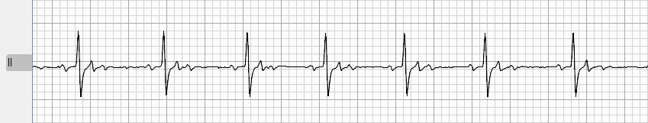
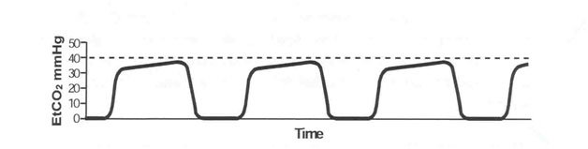
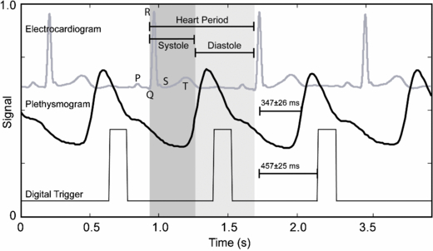
GMVEMSC PREHOSPITAL PARAMEDIC STANDING ORDERS
TRAINING MANUAL VERSION June 1, 2019
Adult: Patients 16 Years Old and Above
Pediatric: Patients < 16 Years old will be in Pink and Bulleted with a “P”
ADULT and PEDIATRIC ORDERS INDEX
The pulse is the worst way to monitor perfusion. (palpating a carotid / central pulse)
So minimize the value of the central pulse as it’s subjective and highly unreliable…
Use the following instead:
+ECG – narrow complex over 40 bpm
+EtCO₂ of 35-40mmHg
+SpO2 waveform
  reliable (+) predictor
  unreliable (-) predictor
A pseudo PEA condition with narrow complex electrical activity at a rate >40 bpm, EtCO₂ around 35-40 mmHg, and a well shaped SpO₂ capillary waveform in the absence of chest compressions is proof of perfusion.
  Treat the H & T’s! (consult MCP prn)
Question #1 – What is pseudo PEA?
Answer – true PEA / EMD – you may be unable to palpate a pulse that actually exists.
Question #2 - How do you detect it?
Answers:
High ETCO₂ readings (in intubated patients)
+SpO₂ waveform
Cardiac activity on POCUS (point-of-care Ultrasound) / Doppler ultrasound
Presence of an arterial line BP

Slide 41
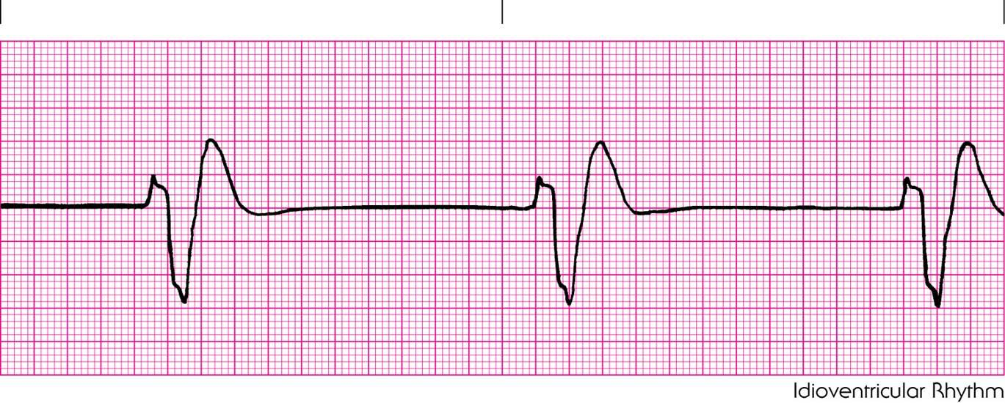
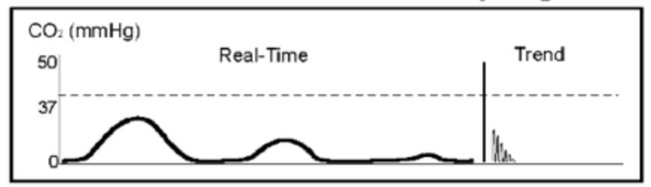
GMVEMSC PREHOSPITAL PARAMEDIC STANDING ORDERS
TRAINING MANUAL VERSION June 1, 2019
Adult: Patients 16 Years Old and Above
Pediatric: Patients < 16 Years old will be in Pink and Bulleted with a “P”
ADULT and PEDIATRIC ORDERS INDEX
So…
Continue CHEST COMPRESSIONS in:
PEA with bad perfusion state indicators:
  Wide bradycardic electric activity
  Low EtCO2 (<20 mmHg)
  No waveform on Pulse Ox
Follow GMVEMSC Protocol and consult with the MCP as necessary.

Slide 42
GMVEMSC PREHOSPITAL PARAMEDIC STANDING ORDERS
TRAINING MANUAL VERSION June 1, 2019
Adult: Patients 16 Years Old and Above
Pediatric: Patients < 16 Years old will be in Pink and Bulleted with a “P”
ADULT and PEDIATRIC ORDERS INDEX
PAGE 27 – NEW SECTION / PAGE
from pg 3 & 5 (continued)
ADULT and PEDIATRIC TRAUMA ARREST
Termination of Resuscitation: CONTACT MCP FOR FIELD TERMINATION
For adult patients in arrest resulting from blunt force or penetrating trauma consider termination of resuscitation (TOR) and or non-transport if:
No immediately reversible cause is found and:
No signs of life as above are present
  Asystole or PEA < 40 without response after rapid primary survey and interventions
  Consider the possibility of mixed mechanisms.
  Be able to provide duration of resuscitation, how long patient was in arrest prior to EMS arrival, witnessed or unwitnessed, EtCO₂, blood glucose and presenting rhythm
  If no ALS equipment is available at the scene and transport time to a medical facility will exceed 20 minutes, field termination may be considered
  Send a copy of the run sheet to the EMS Coordinator of the authorizing MCP’s hospital

Slide 43
GMVEMSC PREHOSPITAL PARAMEDIC STANDING ORDERS
TRAINING MANUAL VERSION June 1, 2019
Adult: Patients 16 Years Old and Above
Pediatric: Patients < 16 Years old will be in Pink and Bulleted with a “P”
ADULT and PEDIATRIC ORDERS INDEX
PAGE 33
2018: BURNS and SMOKE INHALATION
2019 – CHANGES
DO NOT ADMINISTER both Hydroxocobalamin (Cyanokit) and Sodium Thiosulfate to the same patient!
Contact MCP to administer both Hydroxocobalamin and Sodium Thiosulfate to the same patient!
2018: CARBON MONOXIDE (CO) POISONING
Provide high flow O₂ to all suspected CO poisonings.
Pulse oximeter will give false readings and should not be utilized.
{CO oximeter}
Consider Hyperbaric Oxygen treatment for the following patients with suspected CO exposure:
  Underlying cardiovascular disease or symptoms such as chest pain or shortness of breath
  > 60 years of age
  Obvious neurological symptoms (e.g., any interval of unconsciousness, loss of time, inability to perform simple motor tasks, or loss of memory)
  Smoke inhalation victims.
  Pregnancy
Contact MCP to discuss transport considerations.
  KMC has a 24/7 hyperbaric chamber. You must still remove your patient to an emergency facility and then treatment and destination decisions will be determined.
2019 – DELETED


Slide 44
GMVEMSC PREHOSPITAL PARAMEDIC STANDING ORDERS
TRAINING MANUAL VERSION June 1, 2019
Adult: Patients 16 Years Old and Above
Pediatric: Patients < 16 Years old will be in Pink and Bulleted with a “P”
ADULT and PEDIATRIC ORDERS INDEX
Solu-Medrol (METHYLPREDNISOLONE) is intended to augment standard therapy for anaphylaxis, allergic reaction, and to address airway edema and inflammation in asthma. No significant change in patient condition in the field should be expected from the administration of Solu-Medrol. This medication is intended for cases that are of a more urgent nature. A general guideline would be not to initiate an IV only to administer this medication when patient condition otherwise does not warrant an IV start. There is definite, time dependent benefit to Solu-Medrol making field administration of significant value. Solu-Medrol will be given to all patients treated within the allergic reaction or anaphylaxis protocol only after all other applicable first-line medications have been delivered.
Solu-Medrol 80 mg IV.
Solu-Medrol 2 mg/kg IV, max dose 80 mg.
DO NOT EXPECT FIELD RESULTS FROM SOLU-MEDROL.
NOTE: National guidelines now recommend higher Epinephrine dosing for asthma and anaphylaxis in the 0.5 mg range as an initial dose for the average adult. That is the reason for the orders change to use either both of the EpiPens in the drug bag (0.3 mg + 0.15 mg = 0.45 mg) or ~ 0.5 mg IM.
2018: ASTHMA or EMPHYSEMA or COPD
Consider Albuterol 2.5 mg and Ipratropium 0.5 mg, nebulized with O₂ @ 8-10 LPM.
If a conscious patient requires intubation:
Consider Lidocaine 100 mg IN half dose per nostril or added to above nebulizer.
Lidocaine 1.5 mg/kg nebulized with 8-10 LPM O₂ or IN. Maximum dose is 100 mg.
May repeat Albuterol 2.5 mg nebulized X 2.
If patient is intubated, Albuterol 2.5 mg by nebulizer into the ETT. If Ipratropium not given before intubation, add to first Albuterol.
A patient who has received a breathing treatment should be transported for evaluation.
For any patient who is bronchial constricted: CPAP or {Bi-PAP}
After intubation of an asthma patient, limit rate of ventilation to avoid auto-PEEP and hypotension, provided that you can adequately oxygenate the patient at below rate:
8-10 breaths per minute for adults
10-15 breaths per minute for pediatric patients.
Consider bilateral needle decompression if:
  Patient arrests.
  Patient has unilateral or bilateral diminished breath sounds and is hemodynamically unstable.
For asthmatics in distress:
If < 15 kg, EpiPen Jr or Epi (1:1,000) 0.01 mg/kg IM (max 0.15 mg).
If ≥ 15 kg and < 30 kg, Adult EpiPen or Epi (1:1,000) 0.01 mg/kg IM (max 0.3 mg)
♦ May repeat Epi (1:1,000) 0.01 mg/kg IM (max 0.5 mg) after 5 minutes.
      If ≥ 30 kg, give both Adult EpiPen and EpiPen Jr or Epi (1:1,000) 0.5 mg IM
      ♦ May repeat Epi (1:1,000) 0.5 mg IM after 5 minutes.
PAGE 37
2019 –  DELETED
You no longer need to call for REPEAT EPINEPHRINE!

Slide 45
GMVEMSC PREHOSPITAL PARAMEDIC STANDING ORDERS
TRAINING MANUAL VERSION June 1, 2019
Adult: Patients 16 Years Old and Above
Pediatric: Patients < 16 Years old will be in Pink and Bulleted with a “P”
ADULT and PEDIATRIC ORDERS INDEX
2018: ALLERGIC REACTION or ANAPHYLAXIS
Epinephrine is the mainstay of anaphylaxis in allergic reaction treatment. Diphenhydramine alone is not appropriate. Epinephrine is particularly important in cases of any airway edema, hypotension, or when multiple body systems are involved. Advanced age is not a contraindication to epinephrine.
If allergic reaction:
If < 15 kg, EpiPen Jr or Epi (1:1,000) 0.01 mg/kg IM (max 0.15 mg).
If ≥ 15 kg and < 30 kg, Adult EpiPen or Epi (1:1,000) 0.01 mg/kg IM (max 0.3 mg)
♦ May repeat Epi (1:1,000) 0.01 mg/kg IM (max 0.5 mg) after 5 minutes.
  If ≥ 30 kg, give both Adult EpiPen and EpiPen Jr or Epi (1:1,000) 0.5 mg IM
  May repeat Epi (1:1,000) 0.5 mg IM after 5 minutes.
If applicable, apply cold pack.
If patient deteriorating or unresponsive, consider early intubation, possibly with smaller than normal ETT.
If patient is wheezing: Albuterol 2.5 mg and Ipratropium 0.5 mg in nebulizer with O₂ flowing at 8-10 LPM.
If a conscious patient requires intubation, consider:
  Applying Lidocaine Jelly to the ET tube.
Lidocaine 100 mg IN: half dose per nostril or nebulized with 8-10 LPM O₂
Lidocaine 1.5 mg/kg nebulized or IN with 8-10 LPM O₂. Maximum dose is 100 mg.
Albuterol may be repeated x 2.
If patient is intubated, Albuterol 2.5 mg by nebulizer into the ETT. If Ipratropium not given before intubation, add to first Albuterol.
If hypotensive, IV fluid to maintain SBP >100.
If hypotensive, IV fluid IV 20 ml/kg to maintain adequate perfusion.
Diphenhydramine 50 mg IM or IV
Diphenhydramine 1 mg/kg IM or IV (max dose 50 mg)
If patient remains hypotensive after IV fluid, Epi (1:10,000) 0.1 mg, slow IV, every 3 minutes up to 0.5 mg.
For patients unresponsive to Epi, administer Glucagon 1mg IV. If no IV, Glucagon 1 mg IM.
Solu-Medrol (METHYLPREDNISOLONE) is intended to augment standard therapy for anaphylaxis, allergic reaction, and to address airway edema and inflammation in asthma. No significant change in patient condition in the field should be expected from the administration of Solu-Medrol. This medication is intended for cases that are of a more urgent nature. A general guideline would be not to initiate an IV only to administer this medication when patient condition otherwise does not warrant an IV start. There is definite, time dependent benefit to Solu-Medrol making field administration of significant value. Solu-Medrol will be given to all patients treated within the allergic reaction or anaphylaxis protocol only after all other applicable first-line medications have been delivered.
Solu-Medrol 80 mg IV.
Solu-Medrol 2 mg/kg IV, max dose 80 mg.
PAGE 38
2019 –  DELETED
You no longer need to call for REPEAT EPINEPHRINE!

Slide 46
GMVEMSC PREHOSPITAL PARAMEDIC STANDING ORDERS
TRAINING MANUAL VERSION June 1, 2019
Adult: Patients 16 Years Old and Above
Pediatric: Patients < 16 Years old will be in Pink and Bulleted with a “P”
ADULT and PEDIATRIC ORDERS INDEX
PAGE 40
SEIZURES
BVM and nasopharyngeal airway during seizure as needed.
A If seizing, Midazolam 10 mg, IN (5 mg in each nostril) or 2 mg slow IV, or 4 mg IM
A Repeat Midazolam 5 mg IN (2.5 mg in each nostril) after 5 minutes.
A Or repeat Midazolam 2 mg IV after 5 minutes.
A Or repeat Midazolam 4 mg IM after 10 minutes.
Ρ If seizing, Midazolam 0.2 mg/kg IN (max dose 4 mg) or Midazolam 0.1 mg/kg slow IV, (max dose 2 mg) or Midazolam 0.2 mg/kg IM (max dose 4 mg).
Ρ If still seizing, repeat one-half of all initial Midazolam doses except NO IM REPEAT.
If glucose < 60, or there is strong suspicion of hypoglycemia, treat for hypoglycemia.
Maintain normothermia.
When obtaining history be sure to include the following:
Description of seizures, areas of body involved, and duration.
Other known medical history (e.g., head injury, diabetes, drugs, alcohol, stroke, heart disease)
CHANGED ➔

Slide 47
GMVEMSC PREHOSPITAL PARAMEDIC STANDING ORDERS
TRAINING MANUAL VERSION June 1, 2019
Adult: Patients 16 Years Old and Above
Pediatric: Patients < 16 Years old will be in Pink and Bulleted with a “P”
ADULT and PEDIATRIC ORDERS INDEX
PAGE 50
2019 – Modifications
PATIENT CAPACITY, CONSENT, PSYCHIATRIC and COMBATIVE PATIENTS
This section MODIFIED for 2019:
Combative patients, including those with excited delirium, which refers to qualities of irrational behavior: aggression, violence, and paranoia in the patient. This state can result from a number of causes including cocaine intoxication, psychiatric illness, hypoglycemia and other medical illnesses. During excited delirium the patient often becomes significantly hyperthermic. Excited delirium increases the body’s need for oxygen.
A Ketamine 250 mg IM (anterolateral thigh, wait 2 minutes, if desired effect is not achieved, repeat 250 mg in opposite thigh).
A Or Ketamine 100 mg slow IV.
A After 5 minutes and an additional drug bag is available, may repeat Ketamine 250 mg IM (anterolateral thigh, wait two minutes, if desired effect is not achieved, repeat 250 mg in opposite thigh).
A Or repeat Ketamine 100 mg IV after 5 minutes.
And OR:
A Midazolam 10 mg IN (5 mg each nostril), or Midazolam 2 mg slow IV or Midazolam 4 mg IM.
A Or repeat Midazolam 5 mg IN (5 mg in each nostril) after 5 minutes.
A Or repeat Midazolam 2 mg IV after 5 minutes.
A Or repeat Midazolam 4 mg IM after 10 minutes.
Ρ Consider Ketamine, if patient is age 8 or greater, 1 mg/kg slow IV (max dose 100 mg) or
Ketamine 5 mg/kg IM (max dose 250 mg per site with max total of 500 mg).
Ρ Or Midazolam 0.2 mg/kg IN (max dose 4 mg) or Midazolam 0.1 mg/kg slow IV (max dose 2 mg), or 0.2 mg/kg IM (max dose 4 mg) as a chemical restraint.
Ρ ♦ Call MCP for repeat Ketamine, Midazolam.
A If an excited delirium patient goes into arrest:
  Consider Sodium Bicarbonate 100 mEq IV
ADDED ➔
CHANGED from 10 to 5 minutes ➔
CHANGED dose from 10mg to 5 mg ➔
ERROR – 2.5mg in EACH nostril!

Slide 48
GMVEMSC PREHOSPITAL PARAMEDIC STANDING ORDERS
TRAINING MANUAL VERSION June 1, 2019
Adult: Patients 16 Years Old and Above
Pediatric: Patients < 16 Years old will be in Pink and Bulleted with a “P”
ADULT and PEDIATRIC ORDERS INDEX
EPINEPHRINE EPIPEN
PACKAGED: 1:10,000—l mg/10ml (6 in drug bag) 10 ml prefilled syringe
1:1,000—30 ml vial, 1 mg/ml
Auto-injector: Adult 0.3 mg
  Or JR. 0.15 mg
INDICATIONS:
VF, pulseless VT, asystole, PEA Asthma in severe distress
Anaphylaxis or allergic reaction in patients who remain hypotensive after fluid bolus
ADULT:
VF, pulseless VT, asystole and PEA:
1 mg IV 1:10,000, repeat every 3-5 minutes
Asthma, anaphylaxis:
If ≥ 30 kg, give both Adult EpiPen and EpiPen Jr or Epi (1:1,000) 0.5 mg IM
May repeat in 5 minutes
Allergic Reaction, Anaphylaxis in patients who remain hypotensive after fluid bolus: 0.1 mg, 1:10,000, slow IV, every 3 minutes, up to 0.5 mg.
PEDI:
VF, PULSELESS VT, Asystole and PEA, Bradycardia:
0.01 mg/kg of 1:10,000 IV; repeat every 3-5 min.
Asthma, Anaphylaxis:
Ρ If < 15 kg, EpiPen Jr or Epi (1:1,000) 0.01 mg/kg IM (max 0.15 mg).
Ρ If ≥ 15 kg and < 30 kg, Adult EpiPen or Epi (1:1,000) 0.01 mg/kg IM (max 0.3 mg)
Ρ May repeat Epi (1:1,000) 0.01 mg/kg IM (max 0.5 mg) after 5 minutes.
THERAPEUTIC ACTION:
Directly stimulates alpha and beta adrenergic receptors in dose-related fashion; causes bronchodilation, vasoconstriction, and increased cardiac output.
CONTRAINDICATIONS:
PRECAUTIONS AND SIDE EFFECTS:
Headache, nausea, restlessness, weakness, dysrhythmias, including ventricular tachycardia and ventricular fibrillation, hypertension, precipitation of angina pectoris, tachycardia
May increase myocardial oxygen demand
Syncope has occurred following epinephrine administration to asthmatic children.
REQUIRES MCP:
ADULT: For arrest—No.
      For repeat in asthmas, anaphylaxis --No
PEDI: For arrest - No
For repeat in asthmas, anaphylaxis —No
PAGE 79
2019 –  DELETED
All references related to calling the MCP for ADULT & PEDIATRICS removed for REPEAT EPINEPHRINE!

Slide 49
GMVEMSC PREHOSPITAL PARAMEDIC STANDING ORDERS
TRAINING MANUAL VERSION June 1, 2019
Adult: Patients 16 Years Old and Above
Pediatric: Patients < 16 Years old will be in Pink and Bulleted with a “P”
ADULT and PEDIATRIC ORDERS INDEX
PAGE 87
LACTATED RINGERS
PACKAGED: Flexible, non-latex plastic materials, generally with a pH of 6.5. 1000 cc
INDICATIONS:
Solution for fluid and electrolyte replenishment
Hypovolemia
Flushing of wounds
Shock
Pulmonary edema with systolic BP over 100 mmHg
Sepsis
ADULT: Non traumatic shock without pulmonary edema: 500 ml
  Non traumatic shock with pulmonary edema: 250 ml
  Sepsis: 1 L
  Penetrating trauma to chest or abdomen: enough fluid to obtain a radial pulse
  Crush syndrome: if hypotensive 1 L
  Heat exposure: 500 ml
PEDI: 20 ml/kg
THERAPEUTIC ACTION:
CONTRAINDICATIONS:
PRECAUTIONS AND SIDE EFFECTS:
REQUIRES MCP:
  Adult: No
PEDI: No
2019 – ADDED NEW PAGE
Note: Each fluid in the GMVEMSC Formulary includes this statement…
There isn’t a specific protocol for fluid with “Heat Exposure’.

Slide 50
GMVEMSC PREHOSPITAL PARAMEDIC STANDING ORDERS
TRAINING MANUAL VERSION June 1, 2019
Adult: Patients 16 Years Old and Above
Pediatric: Patients < 16 Years old will be in Pink and Bulleted with a “P”
ADULT and PEDIATRIC ORDERS INDEX
PAGE 96
(LEVOPHED)
PACKAGED: 4 mg/4ml for dilution in 250 ml of IV fluids
NOTE: Protect from light.
INDICATIONS: For blood pressure control in acute hypotensive states in the non-trauma patient.
As an adjunct in the treatment of cardiac arrest and profound hypotension.
ADULT: Add 4 mg to 250 ml of IV fluids. Infuse starting at 30 drops per minute (max 45 drops) with 60 drop tubing and titrate to effect. Increase by 5 drops every 5 minutes.
PEDI: ♦ Contact MCP for dosing and administration guidance.
THERAPEUTIC ACTION: Peripheral vasoconstrictor. Positive inotrope (increases cardiac contractility) and chronotrope (increases heart rate).
CONTRAINDICATIONS: Should not be given to patients who are hypotensive from acute hemorrhage.
PRECAUTIONS AND SIDE EFFECTS:
THIS DRUG MUST BE DILUTED BEFORE ADMINISTRATION.
Avoid hypertension. Administer in free-flowing IV and watch for infiltration. If extravasation occurs, stop the infusion immediately as necrosis may occur due to vasoconstrictive action of the drug. Leave the catheter in place so that a reversal agent can be given through the infiltrated catheter.
The infusion must be stopped immediately if it free flows and call MCP.
Do not use the solution if its color is pinkish or darker than slightly yellow or if it contains particles.
REQUIRES MCP:
ADULT: No
PEDI: Yes
2019 – ADDED
Gtts/min = mcg/min
30 = 8
35 = 9.35
40 = 10.7
45 = 12
When mixed per GMVEMSC Standing Orders at:
4mg in 250ml you are infusing 8 mcg/min.
When TTE q5’ you increase from
30 – 35 – 40 – 45 gtts/min
and MAX out at 12 mcg/min
NOTE – CCT / hospital MAX is 30 mcg/min at 113 gtts/min
When you pass your patient off the RN or MD doesn’t want to hear gtts/min they MUST know the DOSE!

Slide 51
GMVEMSC PREHOSPITAL PARAMEDIC STANDING ORDERS
TRAINING MANUAL VERSION June 1, 2019
Adult: Patients 16 Years Old and Above
Pediatric: Patients < 16 Years old will be in Pink and Bulleted with a “P”
ADULT and PEDIATRIC ORDERS INDEX
PAGE 131
2019 - DELETED
WASTED DRUG PROCEDURE
Some hospitals also require the use of the GMVEMSC approved Controlled Drug Usage Form in addition to documentation on the run sheet. This GMVEMSC approved form must be filled out for any controlled drug use, even if there is no wastage. This information shall be on both the original EMS department form and the hospital copy for reference if needed.
A copy of the run report must be left with the drug bag for the pharmacist.
Fentanyl, Ketamine, Morphine, Versed and Valium are controlled drugs. If a medication is only partially administered, the paramedic or AEMT must account for the all of the unused portion.
To insure the medications are properly accounted for, all paramedics and AEMTs will document:
The drug name
The amount used
The amount wasted
The signature of a second witness if there is wastage.
The second witness can be a member of the EMS crew, as many hospital employees are no longer permitted to witness or sign for drug wastage.


Slide 52
GMVEMSC PREHOSPITAL PARAMEDIC STANDING ORDERS
TRAINING MANUAL VERSION June 1, 2019
Adult: Patients 16 Years Old and Above
Pediatric: Patients < 16 Years old will be in Pink and Bulleted with a “P”
ADULT and PEDIATRIC ORDERS INDEX
Clarification!
This form MUST still be used to document usage and waste of
CONTROLLED SUBSTANCES.
Any questions regarding this should be directed to the Drug Bag Committee Chairperson
Question – What is another name for Ketamine?
Answer – Ketalar
Question – What CONTROLLED MEDICATIONS do we have a JITSO for that are NOT routinely carried in the GMVEMSC Drug Bags?
Answer – Diazepam and Morphine
Question – What CONTROLLED MEDICATIONS do we routinely carry in the GMVEMSC Drug Bags?
Answer – Midazolam, Fentanyl, and Ketamine

Slide 53
GMVEMSC PREHOSPITAL PARAMEDIC STANDING ORDERS
TRAINING MANUAL VERSION June 1, 2019
Adult: Patients 16 Years Old and Above
Pediatric: Patients < 16 Years old will be in Pink and Bulleted with a “P”
ADULT and PEDIATRIC ORDERS INDEX
PAGE 140

DELETED

Slide 54
GMVEMSC PREHOSPITAL PARAMEDIC STANDING ORDERS
TRAINING MANUAL VERSION June 1, 2019
Adult: Patients 16 Years Old and Above
Pediatric: Patients < 16 Years old will be in Pink and Bulleted with a “P”
ADULT and PEDIATRIC ORDERS INDEX
PAGE 148
This page changes frequently!
Current when posted…

Slide 55
GMVEMSC PREHOSPITAL PARAMEDIC STANDING ORDERS
TRAINING MANUAL VERSION June 1, 2019
Adult: Patients 16 Years Old and Above
Pediatric: Patients < 16 Years old will be in Pink and Bulleted with a “P”
ADULT and PEDIATRIC ORDERS INDEX
➔
PAGE 149
➔
➔
➔
➔
This page changes often!
Current when posted…
➔
➔
➔
➔
Reminder!
Hospitals in BOLD TYPE are to be called for every patient transport!
➔
➔
➔
➔
➔
➔
➔
➔

Slide 56
GMVEMSC PREHOSPITAL PARAMEDIC STANDING ORDERS
TRAINING MANUAL VERSION June 1, 2019
Adult: Patients 16 Years Old and Above
Pediatric: Patients < 16 Years old will be in Pink and Bulleted with a “P”
ADULT and PEDIATRIC ORDERS INDEX
Skill Sheets MODIFIED for 2019-2020 Skills Evaluations (Competencies)
CPAP Skill Sheet – moved Age Criteria up the algorithm
Intubation Skill Sheet – Changed depth of insertion
Question – What is the MINIMUM BP CRITERIA for CPAP?
Answer – ‘MUST be >100 systolic’
Question – What is the AGE CRITERIA for CPAP?
Answer – ‘Pt MUST be 16 or older’

Slide 57
GMVEMSC PREHOSPITAL PARAMEDIC STANDING ORDERS
TRAINING MANUAL VERSION June 1, 2019
Adult: Patients 16 Years Old and Above
Pediatric: Patients < 16 Years old will be in Pink and Bulleted with a “P”
ADULT and PEDIATRIC ORDERS INDEX
The GMVEMSC Standing Orders and Education Committee would appreciate your feedback.
Please contact the chairs of either committee with your comments or concerns.
Constructive feedback is always appreciated!

Slide 58
GMVEMSC PREHOSPITAL PARAMEDIC STANDING ORDERS
TRAINING MANUAL VERSION June 1, 2019
Adult: Patients 16 Years Old and Above
Pediatric: Patients < 16 Years old will be in Pink and Bulleted with a “P”
ADULT and PEDIATRIC ORDERS INDEX
And Lastly…
Do NOT study for the ANNUAL Protocol CBT from the APP!
Study from the 2019 TRAINING MANUAL for your level of certification.
(The App doesn’t update until June 19)

Slide 59


GMVEMSC PREHOSPITAL PARAMEDIC STANDING ORDERS
TRAINING MANUAL VERSION June 1, 2019
Adult: Patients 16 Years Old and Above
Pediatric: Patients < 16 Years old will be in Pink and Bulleted with a “P”
ADULT and PEDIATRIC ORDERS INDEX
QUESTIONS?
Contact your local EMS Coordinator for answers.

Slide 60
GMVEMSC PREHOSPITAL PARAMEDIC STANDING ORDERS
TRAINING MANUAL VERSION June 1, 2019
Adult: Patients 16 Years Old and Above
Pediatric: Patients < 16 Years old will be in Pink and Bulleted with a “P”
ADULT and PEDIATRIC ORDERS INDEX
https://www.questbase.com/product/qsb/
2019 EMR CBT PIN: 1894-4337-7336
2019 EMT CBT PIN: 1121-3973-50146
2019 AEMT CBT PIN: 8563-1486-5441
2019 Paramedic CBT PIN: 5155-4058-3043
2019 CBT Evaluation PIN: 3611-7570-0323

