Slide 1
CPAP
Mike Callihan RN,BSN, Paramedic, EMSI
Miami Valley Hospital
EMS Education

Slide 2
Objectives
Define Congestive Heart Failure
Define COPD
Review standing orders for CHF and COPD
Describe CPAP
Practice usage of CPAP

Slide 3
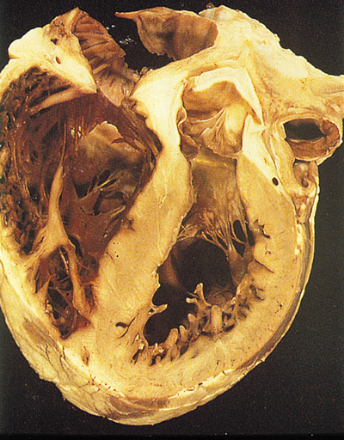
A congested heart

Slide 4
Congestive Heart Failure
Congestive Heart Failure (CHF) is a serious disease associated with excessive morbidity and mortality and of elevated health-care costs.
Even with the advances in pharmacologic therapy, the mortality for the disease remains very high.

Slide 5
Congestive Heart Failure
Approximately 80% of patients with CHF showed restrictive spirometric pattern
Extravascular volume expansion and fluid accumulation in interstitial compartments of the lungs
Fluid accumulation is associated with increased heart size and reduced lung compliance.

Slide 6
Congestive Heart Failure
The accumulation of fluid leads to flooding of the alveoli resulting in a deficiency in gas exchange with several consequences,
Muscle weakness
Dyspnea with routine activities.
Dyspnea progresses into dyspnea at rest.

Slide 7
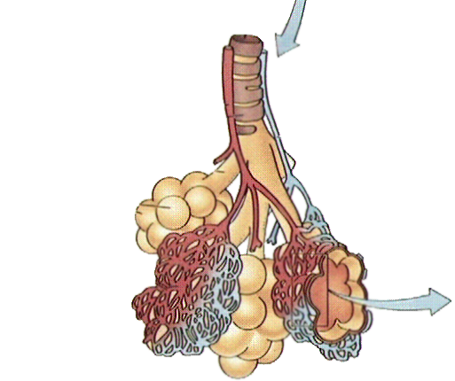
Bronchioles and Alveoli
Oxygenated Blood
to the Heart
Deoxygenated
Blood
from the Heart
Pulmonary
Venule
Bronchus
Bronchiole
Pulmonary
Arteriole
Alveoli
Smallest Blood
Vessels
(Capillaries)
Notes:
Bronchioles and Alveoli are part of the lower airway. Point out the flow of blood.
Point out the Pulmonary Vein is the only vein in the body that carries oxygenated blood and the Pulmonary Artery is the only artery to carry Unoxygenated (Bad) blood
Alveoli is where gas exchange takes place. There are ~300 million, and are incased in the pulmonary capillaries – where gas exchange takes place
Bronchioles act as both a conducting airway and gas exchange area

Slide 8
Pulmonary Edema Protocol
Assess for
Cyanosis
clammy skin
absence of fever
coughing
wheezing, labored breathing
pitting edema
rales in bilateral lower fields
tachypnea
apprehension
JVD
Inability to talk.

Slide 9
Treatment
If CPAP is available, its use is encouraged prior to initiation of drug therapy
If SBP>100, NTG 0.4 mg SL up to 3, 1 every 5minutes. Maintain SBP > 100
Furosemide 80 mg slow IV push over 2 minutes. Maintain SBP >100
Morphine, up to 5 mg, Slow IV over 2 minutes. Maintain SBP > 100. May repeat morphine, up to 5 mg, slow IV over 2 minutes.

Slide 10
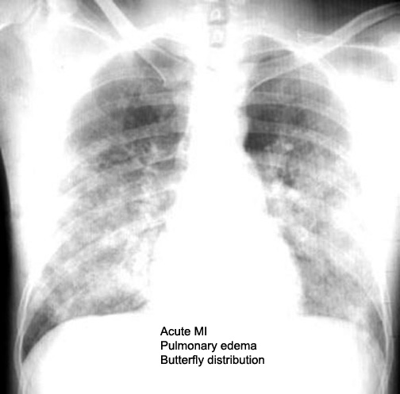
Pulmonary Edema

Slide 11
COPD
COPD, or chronic obstructive pulmonary disease, is a progressive disease that makes it hard to breathe.
"Progressive" means the disease gets worse over time.
COPD can cause coughing that produces large amounts of mucus (a slimy substance), wheezing, shortness of breath, chest tightness, and other symptoms.

Slide 12
COPD
Airways and air sacs are elastic
In COPD, less air flows in and out of the airways because of one or more of the following:
The airways and air sacs lose their elastic quality.
The walls between many of the air sacs are destroyed.
The walls of the airways become thick and inflamed (swollen).
The airways make more mucus than usual, which tends to clog the airways.

Slide 13
COPD
COPD can cause:
coughing that produces large amounts of mucus,
wheezing
shortness of breath
chest tightness
other symptoms.

Slide 14
COPD causes
Cigarette smoking is the leading cause of COPD. Most people who have COPD smoke or used to smoke.
Long-term exposure to other lung irritants, such as air pollution, chemical fumes, or dust, also may contribute to COPD.

Slide 15
Asthma/Emphysema/COPD
Consider albuterol 2.5 mg and ipratropium 0.5 mg, nebulized with O2 8-12 LPM.
May repeat Albuterol 2.5 mg nebulized X 2.
COPD, CPAP or BiPAP
If patient arrests, tension pneumothorax is a likely cause
For asthmatics in severe distress: Epinephrine (1:1000) .3 mg SQ or autoinjector.
With Med control approval, may repeat Epinephrine.

Slide 16
So what is CPAP?

Slide 17
CPAP
Continuous positive airway pressure
CPAP is a tool to be used for assisting ventilation and should not be confused with trying correct Oxygenation concerns

Slide 18
Indications
Medical history and presenting complaints consistent with pulmonary edema
Patient must be 16 or older
COPD, Asthma
Bibasilar or diffuse rales
Near drowning
Disasters or mass casualties such as Bioterrorism with cases of respiratory distress

Slide 19
Contraindications
Respiratory or cardiac arrest
Agonal respirations
Severely depressed level of consciousness
Systolic blood pressure < 90mmHg
Signs and symptoms of pneumothorax
Inability to maintain airway patency
Major trauma, especially head injury with increased ICP or significant chest trauma
Facial Anomalies, e.g., burns, fractures
Vomiting
If patient deteriorates while on CPAP (O₂ sats < 90), then prepare to intubate

Slide 20
Hazards of CPAP
Hypotension
Pneumothorax
Corneal Drying

Slide 21
Benefits to CPAP
The main direct benefits of CPAP are improved oxygenation, decreased respiratory effort, and decrease in left ventricular preload and afterload.
A recent study showed that with 2 weeks of CPAP usage for patients with CHF, pulmonary function was improved.

Slide 22
Goals of CPAP
Elimination of dyspnea
Reduced respiratory rate
Reduced heart rate
Increased SpO2
Stabilized blood pressure

Slide 23
Important
Once a patient is started on CPAP, only remove treatment if the patient deteriorates or under medical control direction.
Call ahead to ER and inform them that patient is on CPAP, do not just unhook the patient and leave.

Slide 24
Summary
CPAP has been found to be as affective or more affective than the conventional pharmacological interventions.
CPAP is now being used as a part of GMVEMSC protocol

